Slide 1







01 Energy
AQA GCSE COMBINED SCIENCE
02 Electricity
PHYSICS
03 Particle Model of Matter
Knowledge Organiser
04 Atomic Structure
05 Forces
All 7 topics · key facts · diagrams · every equation with worked examples · required practicals · examiner tips
Foundation & Higher tier
06 Waves
OPEN THE INDEX ›
07 Magnetism & Electromagnetism

Slide 2


Index
CLICK ANY TOPIC OR PAGE TO JUMP STRAIGHT TO IT
01
02
03
04
Energy
Electricity
Particle Model
Atomic Structure
4 Energy stores & systems
13 Current, p.d. & resistance
23 States of matter & density
29 Atoms & atomic models
5 Equations
14 Circuit symbols & sensors
24 Internal energy & state
30 Isotopes & radiation
6 Worked examples (1)
15 Series & parallel circuits
25 Latent heat & gas pressure
31 Nuclear decay equations
7 Worked examples (2)
16 Mains & the National Grid
26 Worked examples
32 Half-life & contamination
8 Efficiency & Sankey diagrams
17 Equations
27 Examiner tips
33 Examiner tips
9 Wasted energy & SHC practical
18 Worked examples (1)
10 Energy resources
19 Worked examples (2)
20 Required practicals
11 Examiner tips
21 Examiner tips
05
06
07
08
Forces
Waves
Magnetism & EM
Equation Bank
35 Scalars, vectors & forces
46 Wave types & properties
53 Magnets & magnetic fields
58 All equations by topic
36 Resultants & work done
47 Measuring waves
54 Electromagnetism
59 Equation sheet & units
37 Forces & elasticity
48 EM spectrum
55 The motor effect
38 Speed & motion graphs
49 Refraction & infrared
56 Examiner tips
39 Newton’s laws
40 Stopping & momentum
50 Equations & examples
41 Equations
51 Examiner tips
42 Worked examples (1)
43 Worked examples (2)
44 Examiner tips

Slide 3

Energy
01
‹ INDEX
IN THIS TOPIC
4 Energy stores & systems
5 Energy equations
6 Energy worked examples (1)
7 Energy worked examples (2)
Stores, transfers, power, efficiency & resources
8 Efficiency & Sankey diagrams
9 Wasted energy & SHC practical
10 Energy resources
11 Examiner tips

Slide 4








Energy stores & systems
TOPIC 1 · ENERGY
01
‹ INDEX
Conservation of energy
Kinetic
Thermal
Chemical
Elastic potential
Energy can never be created or destroyed – only transferred, stored or dissipated.
Some energy is transferred usefully; the rest is wasted – usually dissipated to the surroundings as thermal energy.
Anything moving
All objects – hotter = more
Fuels, food, batteries
Stretched / squashed
Gravitational PE
Electrostatic
Magnetic
Nuclear
Anything raised up
Charges attract / repel
Magnets attract / repel
Released from the nucleus
Four ways energy is transferred
Systems
1
2
3
4
A system is an object or group of objects.
When a system changes, energy moves between stores.
Closed system: no energy in or out, so no net change in total energy.
Mechanically
Electrically
By heating
By radiation
A force does work, e.g. pushing, stretching
Moving charge does work, e.g. a current
Hotter object → cooler object
Waves, e.g. light, infrared, sound

Slide 5
Energy equations
TOPIC 1 · ENERGY
01
‹ INDEX
KINETIC ENERGY
EXAMPLE › 6
GRAVITATIONAL PE
EXAMPLE › 6
ELASTIC PE
EXAMPLE › 7
SPECIFIC HEAT CAPACITY
EXAMPLE › 6
E_{k} = ½ m v²
E_{p} = m g h
E_{e} = ½ k e²
ΔE = m c Δθ
E_{k} in J · m in kg · v in m/s
J · kg · g in N/kg · h in m
J · k in N/m · e (extension) in m
J · kg · c in J/kg °C · Δθ in °C
POWER (ENERGY)
EXAMPLE › 7
POWER (WORK)
EXAMPLE › 7
EFFICIENCY (ENERGY)
EXAMPLE › 8
EFFICIENCY (POWER)
EXAMPLE › 8
P = E ÷ t
P = W ÷ t
useful energy out ÷ total energy in
useful power out ÷ total power in
P in W · E in J · t in s
P in W · W (work done) in J · t in s
× 100 for a percentage
× 100 for a percentage

Slide 6
Energy worked examples (1)
TOPIC 1 · ENERGY
01
‹ INDEX
WORKED EXAMPLE
WORKED EXAMPLE
A 1200 kg car travels at 15 m/s. Calculate its kinetic energy.
E_{k} = ½ m v²
= 0.5 × 1200 × 15²
= 0.5 × 1200 × 225
A 2 kg bag is lifted 5 m onto a shelf (g = 9.8 N/kg). Find the gain in GPE.
E_{p} = m g h
= 2 × 9.8 × 5
E_{k} = 135 000 J
E_{p} = 98 J
WORKED EXAMPLE
WORKED EXAMPLE
0.5 kg of water is heated from 20 °C to 40 °C (c = 4200 J/kg °C). How much energy is needed?
Δθ = 40 − 20 = 20 °C
ΔE = m c Δθ = 0.5 × 4200 × 20
A motor is supplied with 500 J and transfers 150 J usefully. Calculate its efficiency.
efficiency = useful out ÷ total in
= 150 ÷ 500 = 0.30
ΔE = 42 000 J
Efficiency = 0.30 = 30%

Slide 7
Energy worked examples (2)
TOPIC 1 · ENERGY
01
‹ INDEX
WORKED EXAMPLE
WORKED EXAMPLE
WORKED EXAMPLE
A spring (k = 40 N/m) is stretched by 0.05 m. Find the elastic potential energy stored.
E_{e} = ½ k e²
= 0.5 × 40 × 0.05²
= 0.5 × 40 × 0.0025
A kettle transfers 180 000 J in 1 minute. Find its power.
t = 60 s
P = E ÷ t = 180 000 ÷ 60
A crane does 24 000 J of work lifting a load in 12 s. Find its power.
P = W ÷ t
= 24 000 ÷ 12
E_{e} = 0.05 J
P = 3000 W
P = 2000 W
WORKED EXAMPLE
WORKED EXAMPLE
WORKED EXAMPLE
A 0.5 kg ball gains 20 J of GPE (g = 9.8 N/kg). How high was it lifted?
h = E_{p} ÷ (m g)
= 20 ÷ (0.5 × 9.8)
A ball is dropped from 5 m. Ignoring air resistance, find its landing speed (g = 9.8 N/kg).
GPE lost = KE gained: m g h = ½ m v²
v = √(2 g h) = √(2 × 9.8 × 5)
36 000 J warms 2 kg of a metal by 10 °C. Find its specific heat capacity.
c = ΔE ÷ (m Δθ)
= 36 000 ÷ (2 × 10)
h = 4.1 m
v = 9.9 m/s
c = 1800 J/kg °C

Slide 8
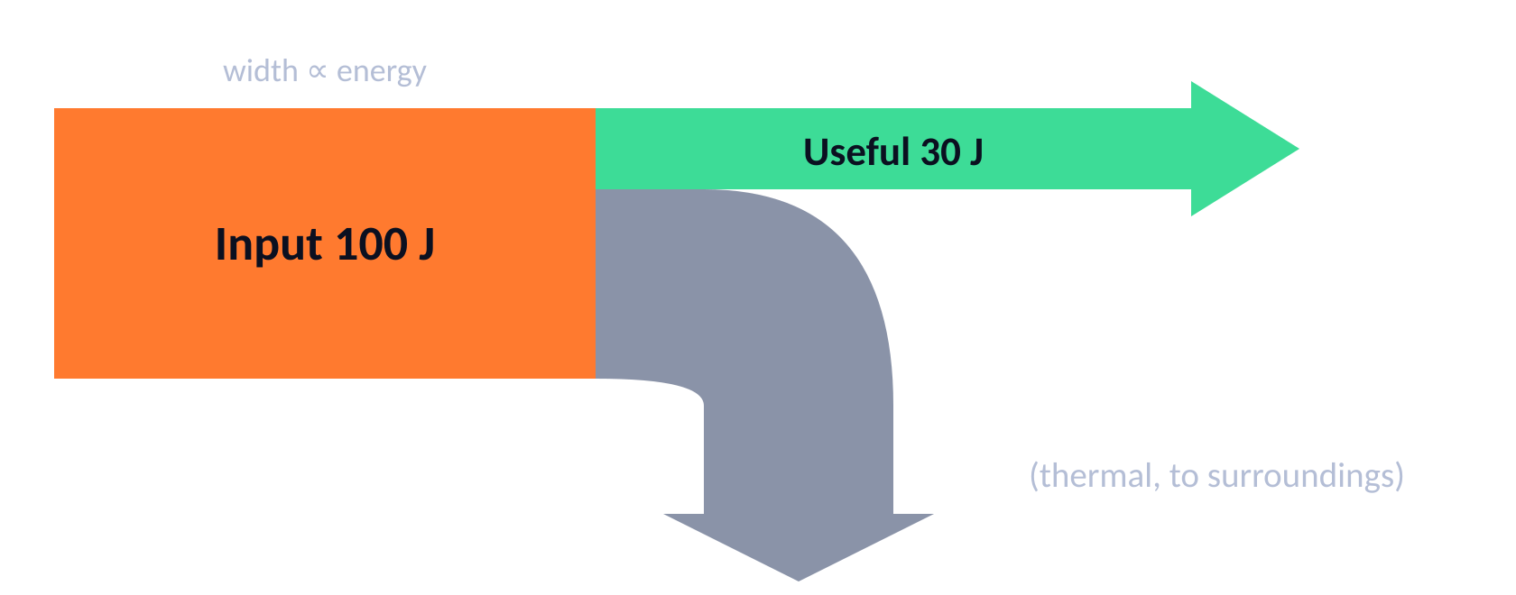
Efficiency & Sankey diagrams
TOPIC 1 · ENERGY
01
‹ INDEX
Sankey diagram
WORKED EXAMPLE
A motor is supplied with 400 W; its useful output is 300 W. Find its efficiency.
300 ÷ 400 = 0.75
Efficiency = 75%
WORKED EXAMPLE
A 60% efficient bulb is supplied with 500 J. Find the useful energy output.
useful = 0.6 × 500
Useful = 300 J
Efficiency
efficiency = useful output ÷ total input (energy or power).
× 100 for a percentage. No units; never more than 1 (100%).
Improve it: lubricate moving parts, insulate to cut heat loss.
WORKED EXAMPLE
A 1200 W heater is 90% efficient. How much power is wasted?
useful = 0.9 × 1200 = 1080 W; wasted = 1200 − 1080
Wasted = 120 W

Slide 9
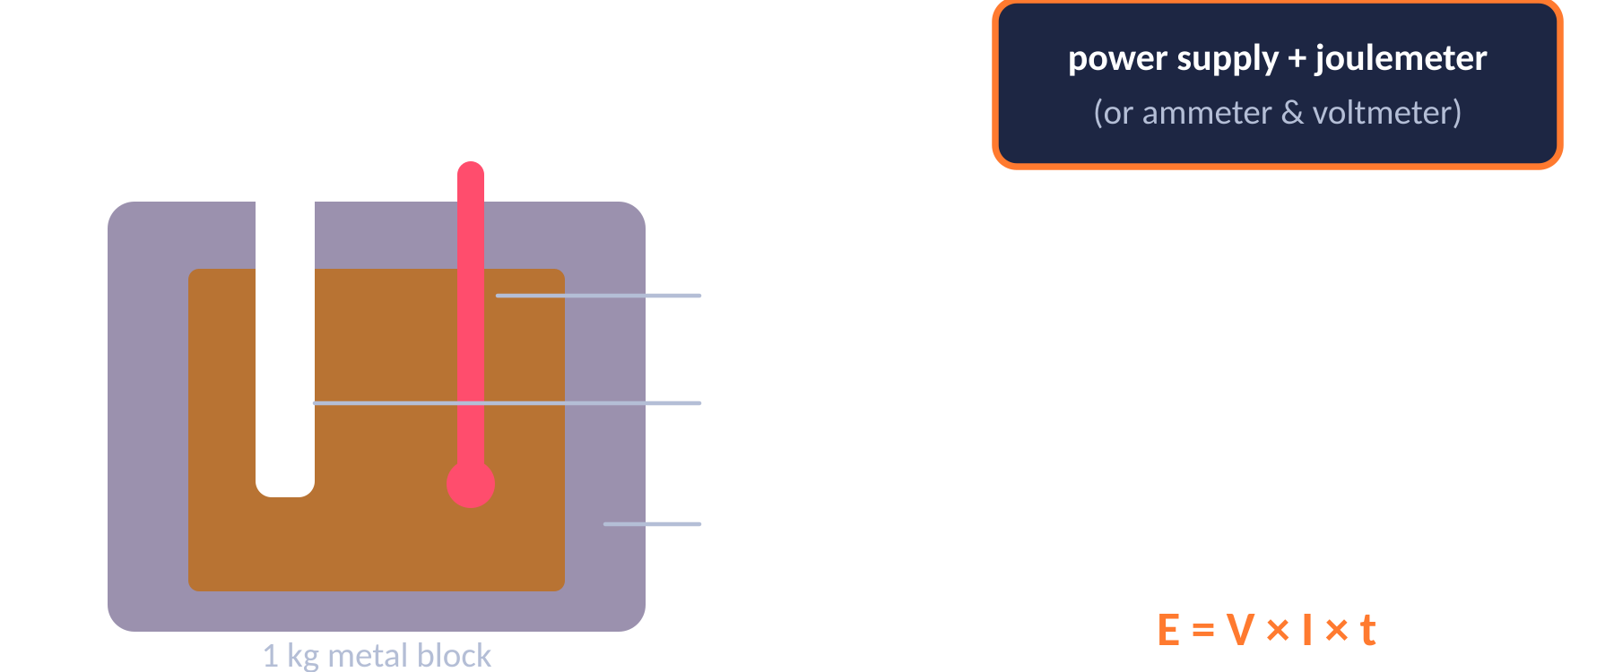
Wasted energy & specific heat capacity
TOPIC 1 · ENERGY
01
‹ INDEX
Required practical: specific heat capacity
Reducing unwanted energy transfers
Method
Lubrication (e.g. oil) reduces friction between moving parts.
Thermal insulation: loft insulation, cavity walls, double glazing, thick walls.
Materials with low thermal conductivity transfer energy more slowly.
Thicker walls → slower rate of cooling.
IV: material DV: temperature rise CV: mass, insulation, p.d.
1. Record V and I; read the temperature every minute for 10 minutes.
2. Energy E = V × I × t. Plot temperature (y) against energy (x).
3. c = 1 ÷ (gradient × mass). Insulation reduces heat loss.

Slide 10
Energy resources
TOPIC 1 · ENERGY
01
‹ INDEX
Resource | Type | Advantages | Disadvantages
Fossil fuels | Non-renewable | Reliable; large output; can meet changing demand | Running out; CO₂ → global warming; SO₂ → acid rain
Nuclear | Non-renewable | Reliable; no CO₂; huge energy from little fuel | Radioactive waste; expensive to build & decommission
Biofuels | Renewable | Reliable; “carbon neutral” | Land use; forests cleared to grow crops
Wind | Renewable | No pollution; low running cost | Unreliable – no wind, no power; noisy / visual impact
Hydroelectric | Renewable | No pollution; supply can be increased quickly | Flooding destroys habitats
Geothermal | Renewable | Reliable – rocks always hot; small impact | Only in volcanic areas; may release gases
Tidal | Renewable | Very reliable & predictable; no pollution | Alters estuary habitats; fish harmed
Waves | Renewable | No pollution | Unreliable; disturbs seabed habitats
Solar | Renewable | No pollution; reliable in sunny places | Only works in daylight; can’t increase supply
Trends
Renewables now generate around half of UK electricity; gas and nuclear supply most of the rest. Barriers to more renewables: cost of new plants, public opposition to local sites, and higher bills.

Slide 11
Examiner tips
TOPIC 1 · ENERGY
01
‹ INDEX
1
Show every step
2
Square only the speed
3
Convert units first
Write the equation, substitute, then calculate – method marks are given even if the final answer is wrong.
In E_{k} = ½ m v², square v first, then multiply by m and ½.
g → kg (÷ 1000), kJ → J (× 1000), minutes → s (× 60).
4
Δθ is a change
5
Efficiency sense-check
6
Use stores & pathways
Temperature change = final − start. Don’t use the final temperature.
No units, and never more than 1 (100%). If yours is bigger, you’ve divided the wrong way.
Say “chemical store → thermal store, by heating” – avoid “heat energy” or “movement energy”.

Slide 12

Electricity
02
‹ INDEX
IN THIS TOPIC
13 Current, p.d. & resistance
14 Circuit symbols, LDRs & thermistors
15 Series & parallel circuits
16 Mains & the National Grid
Circuits, resistance, mains & the National Grid
17 Electricity equations
18 Electricity worked examples (1)
19 Electricity worked examples (2)
20 Required practicals
21 Examiner tips

Slide 13
Current, potential difference & resistance
TOPIC 2 · ELECTRICITY
02
‹ INDEX
I–V characteristics
Current (I) · amps, A
Rate of flow of charge. Only flows in a complete circuit.
Same at every point in a single loop.
Ohmic conductor
Filament lamp
Diode
I
I
I
Potential difference (V) · volts, V
V
V
V
The “push” – energy transferred per unit charge.
Measured with a voltmeter in parallel.
Straight line through origin: I ∝ V at constant temperature. R is constant.
Curve flattens: filament heats up, so resistance increases.
Current flows one way only – very high resistance in reverse.
Resistance (R) · ohms, Ω
Opposes the current. V = I R
Higher R → smaller current for the same p.d.

Slide 14
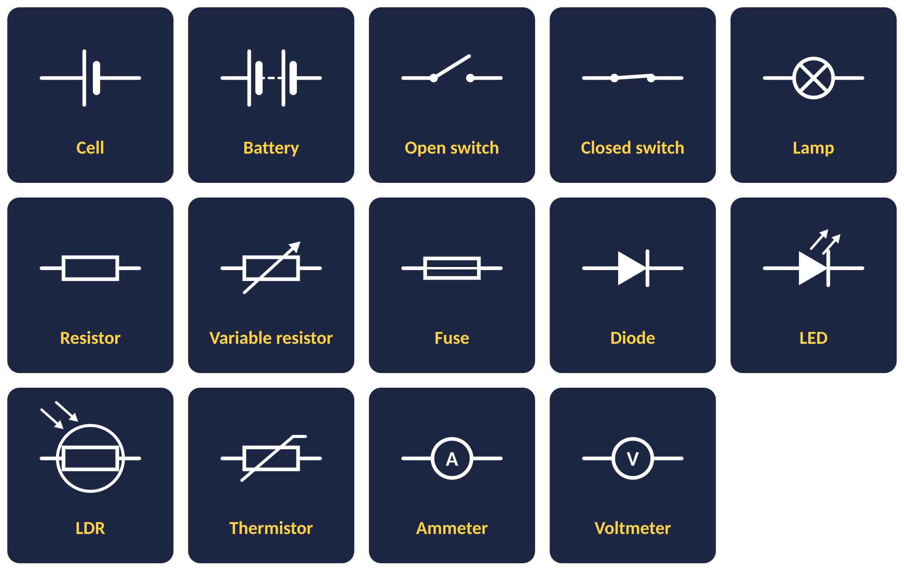
Circuit symbols, LDRs & thermistors
TOPIC 2 · ELECTRICITY
02
‹ INDEX
LDR – light dependent resistor
resistance
Brighter → lower resistance.
Uses: outdoor lights, burglar alarms.
light intensity
Thermistor
resistance
Hotter → lower resistance.
Uses: thermostats, fire alarms.
Ammeters go in series; voltmeters go in parallel across a component.
temperature

Slide 15


Series & parallel circuits
TOPIC 2 · ELECTRICITY
02
‹ INDEX
Series
Parallel
One loop – if one component breaks, everything stops
Separate branches – one can fail, others keep working
Current
I₁ = I₂ = I₃
Current
I_{total} = I₁ + I₂
Same everywhere in the loop
Branch currents add up to the total
P.d.
V_{total} = V₁ + V₂
P.d.
V₁ = V₂
Supply p.d. is shared between components
Every branch gets the full supply p.d.
Resistance
R_{total} = R₁ + R₂
Resistance
R_{total} < smallest R
Adding resistors increases total R
Adding resistors decreases total R

Slide 16
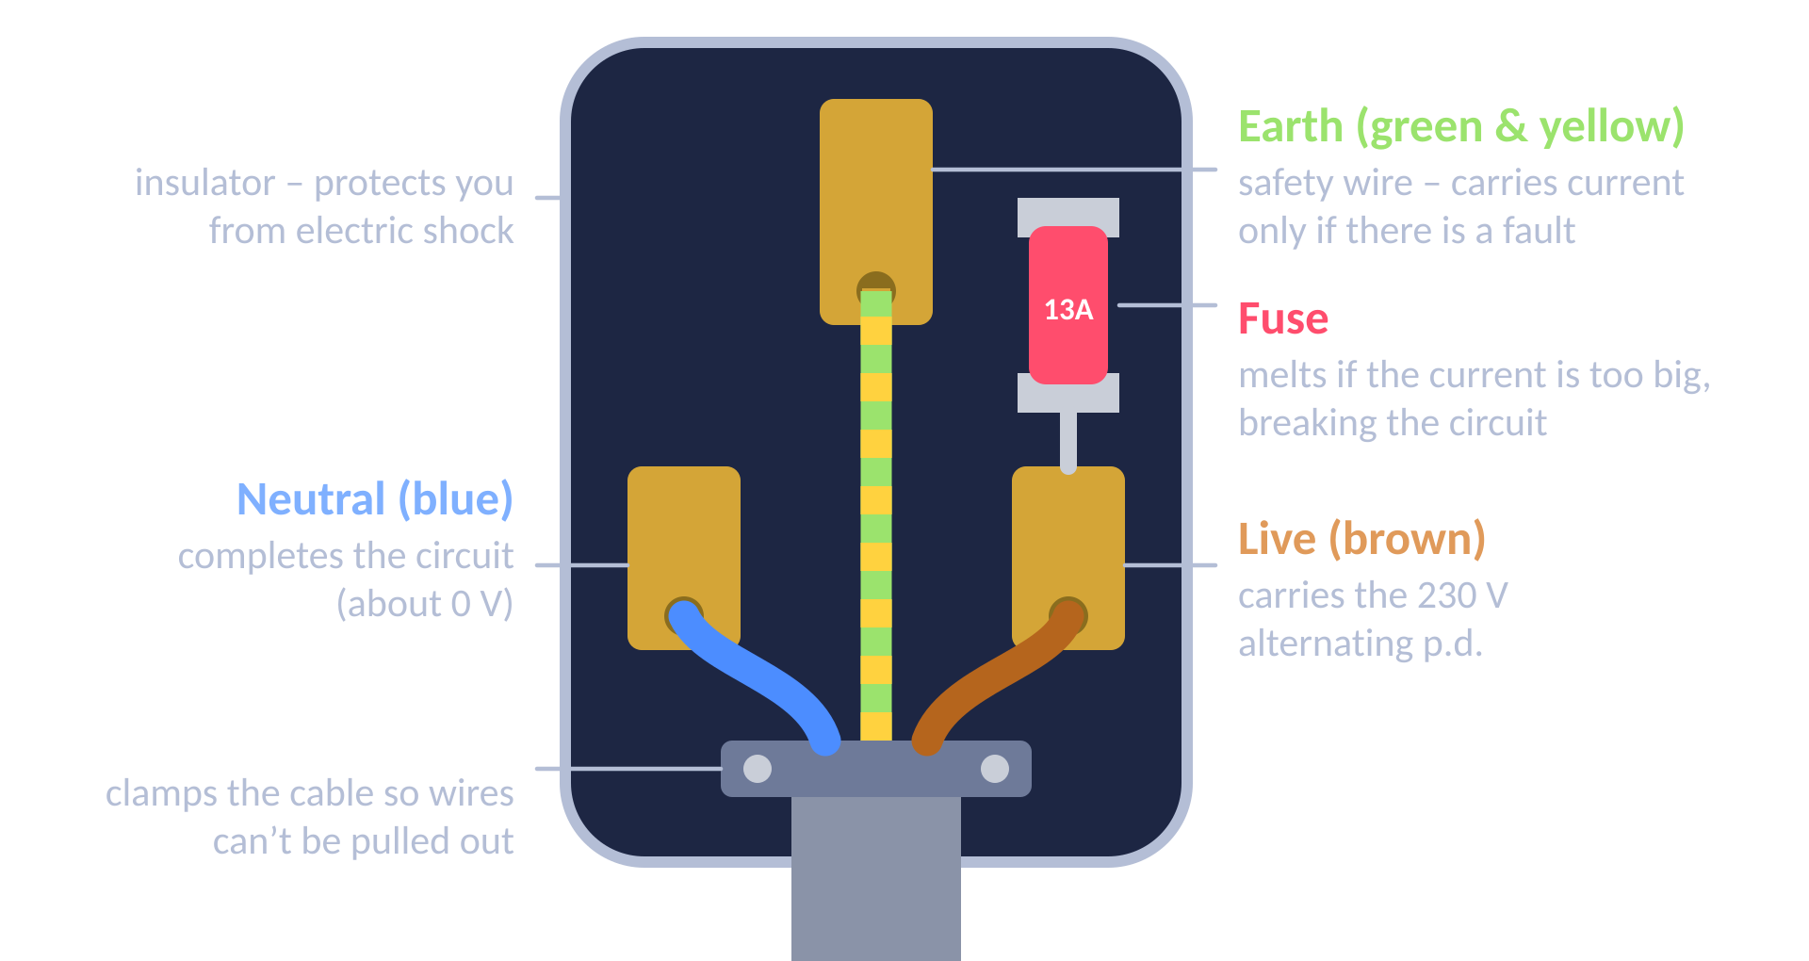
Mains electricity & the National Grid
TOPIC 2 · ELECTRICITY
02
‹ INDEX
230 V
50 Hz
AC vs DC
AC (alternating current): constantly changes direction – the mains supply.
DC (direct current): flows in one direction only – from cells and batteries.
UK mains p.d.
UK mains frequency
The National Grid
Power station
Step-up transformer
Transmission cables
Step-down transformer
Homes
Step-up transformers raise the p.d. to very high values, so the current is low → less energy wasted heating the cables → efficient.
Step-down transformers lower the p.d. to 230 V for use in homes.
Touching the live wire → electric shock, even with the switch off.

Slide 17
Electricity equations
TOPIC 2 · ELECTRICITY
02
‹ INDEX
CHARGE FLOW
EXAMPLE › 18
OHM’S LAW
EXAMPLE › 18
POWER (V & I)
EXAMPLE › 19
POWER (I & R)
EXAMPLE › 18
Q = I t
V = I R
P = V I
P = I² R
Q in C · I in A · t in s
V in V · I in A · R in Ω
P in W · V in V · I in A
P in W · I in A · R in Ω
ENERGY (POWER)
EXAMPLE › 18
ENERGY (CHARGE)
EXAMPLE › 19
SERIES RESISTANCE
EXAMPLE › 18
UNIT CONVERSION
E = P t
E = Q V
R_{total} = R₁ + R₂
1 kW = 1000 W
E in J · P in W · t in s
E in J · Q in C · V in V
All in Ω
0.5 kW = 500 W · 1 min = 60 s

Slide 18
Electricity worked examples (1)
TOPIC 2 · ELECTRICITY
02
‹ INDEX
WORKED EXAMPLE
WORKED EXAMPLE
WORKED EXAMPLE
A current of 2 A flows for 3 minutes. How much charge flows?
t = 3 × 60 = 180 s
Q = I t = 2 × 180
A 40 Ω resistor carries 0.25 A. Find the p.d. across it.
V = I R
= 0.25 × 40
A 12 V supply drives 3 A through a lamp. Find the resistance.
R = V ÷ I
= 12 ÷ 3
Q = 360 C
V = 10 V
R = 4 Ω
WORKED EXAMPLE
WORKED EXAMPLE
WORKED EXAMPLE
A 2 kW kettle is on for 3 minutes. How much energy is transferred?
P = 2000 W, t = 180 s
E = P t = 2000 × 180
3 A flows through an 8 Ω heater. Calculate the power.
P = I² R
= 3² × 8 = 9 × 8
4 Ω and 6 Ω resistors are in series with a 12 V battery. Find the current.
R_{total} = 4 + 6 = 10 Ω
I = V ÷ R = 12 ÷ 10
E = 360 000 J
P = 72 W
I = 1.2 A

Slide 19
Electricity worked examples (2)
TOPIC 2 · ELECTRICITY
02
‹ INDEX
WORKED EXAMPLE
WORKED EXAMPLE
WORKED EXAMPLE
A 230 V toaster draws a current of 4 A. Find its power.
P = V I
= 230 × 4
A 12 V battery moves 50 C of charge. How much energy is transferred?
E = Q V
= 50 × 12
A 60 W lamp runs from a 12 V supply. Find the current.
I = P ÷ V
= 60 ÷ 12
P = 920 W
E = 600 J
I = 5 A
WORKED EXAMPLE
WORKED EXAMPLE
WORKED EXAMPLE
A 4 Ω resistor dissipates 36 W. Find the current through it.
I² = P ÷ R = 36 ÷ 4 = 9
I = √9
Two parallel branches carry 0.4 A and 0.6 A. Find the total current from the supply.
I_{total} = I₁ + I₂
= 0.4 + 0.6
A 9 V battery powers a lamp and a resistor in series. The lamp has 3.5 V across it. Find the p.d. across the resistor.
V_{total} = V₁ + V₂
V₂ = 9 − 3.5
I = 3 A
I = 1.0 A
V = 5.5 V

Slide 20
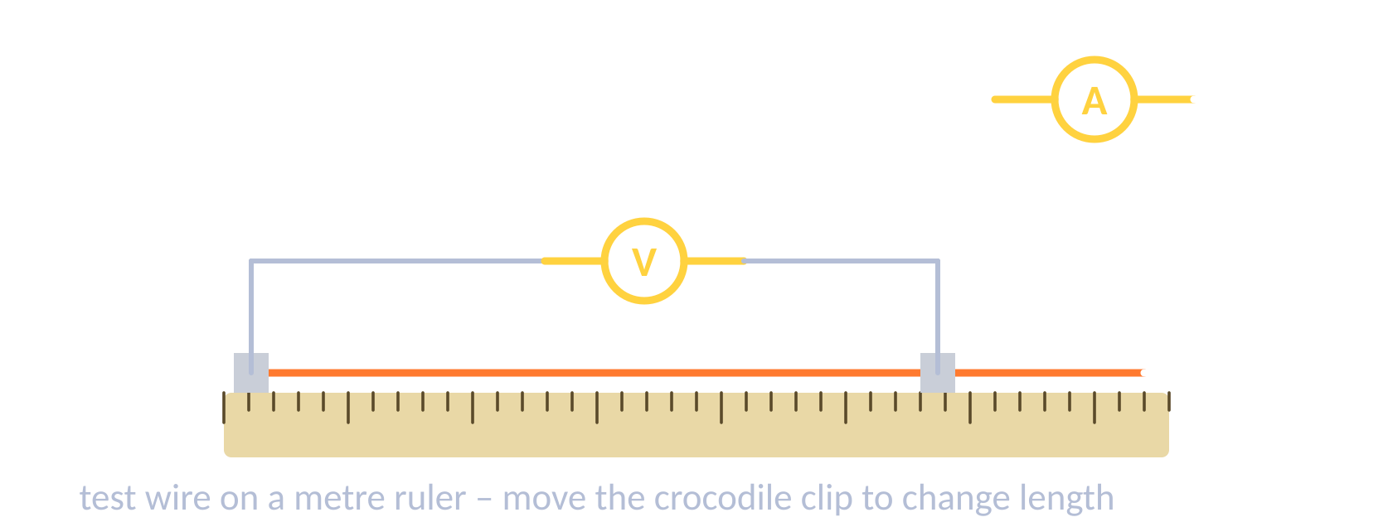

Electricity required practicals
TOPIC 2 · ELECTRICITY
02
‹ INDEX
Resistance of a wire
I–V characteristics
IV: length of wire DV: resistance CV: material, diameter, temperature
1. Clip the wire to a metre ruler; connect with crocodile clips.
2. Ammeter in series, voltmeter across the wire.
3. Measure V and I for different lengths; R = V ÷ I.
Result: resistance is directly proportional to length.
IV: potential difference DV: current CV: component, supply
1. Set up the component with a variable resistor, ammeter in series and voltmeter in parallel.
2. Change the p.d. in steps; record I each time.
3. Reverse the supply connections to get negative values.
4. Plot I (y) against V (x). Repeat for resistor, lamp, diode.

Slide 21
Examiner tips
TOPIC 2 · ELECTRICITY
02
‹ INDEX
1
Meters in the right place
2
Series rules
3
Parallel resistance falls
Ammeter in series, voltmeter in parallel across the component.
Same current everywhere; the supply p.d. is shared between components.
Adding a resistor in parallel decreases total resistance – a favourite “explain” question.
4
Explain the lamp graph
5
Watch the prefixes
6
Safety features
Current ↑ → filament hotter → resistance ↑ → the I–V graph curves.
kW → W (× 1000), mA → A (÷ 1000), minutes → s (× 60).
The fuse melts if the current is too big; the earth wire stops the case becoming live.

Slide 22

Particle Model of Matter
03
‹ INDEX
IN THIS TOPIC
23 States of matter & density
24 Internal energy & state
25 Latent heat & gas pressure
26 Particle model worked examples
Density, states, internal energy & latent heat
27 Examiner tips

Slide 23
States of matter & density
TOPIC 3 · PARTICLE MODEL OF MATTER
03
‹ INDEX
Solid
Liquid
Gas
Strong forces; fixed, regular pattern. Particles only vibrate. Least energy.
Weaker forces; close together but can move past each other. Irregular.
Almost no forces; far apart, move fast in random directions. Most energy.
ρ = m ÷ V
Density
Density = how much mass is packed into a given volume.
Solids are usually most dense, gases least – gas particles are spread far apart.
A denser material has more particles in the same volume.
density (kg/m³) = mass (kg) ÷ volume (m³)

Slide 24
Internal energy & changes of state
TOPIC 3 · PARTICLE MODEL OF MATTER
03
‹ INDEX
Heating curve for water
Internal energy
gas
Internal energy = total kinetic + potential energy of all the particles in a system.
Heating increases internal energy → either a temperature rise or a change of state.
temperature (°C)
boiling (100 °C)
liquid
Changes of state
melting (0 °C)
Melting S→L Freezing L→S
Boiling/evaporating L→G Condensing G→L
Sublimating S→G
A physical change – it is reversible and mass is conserved. No new substance forms.
solid
time
Flat sections: energy breaks bonds, so temperature stays constant while state changes.

Slide 25
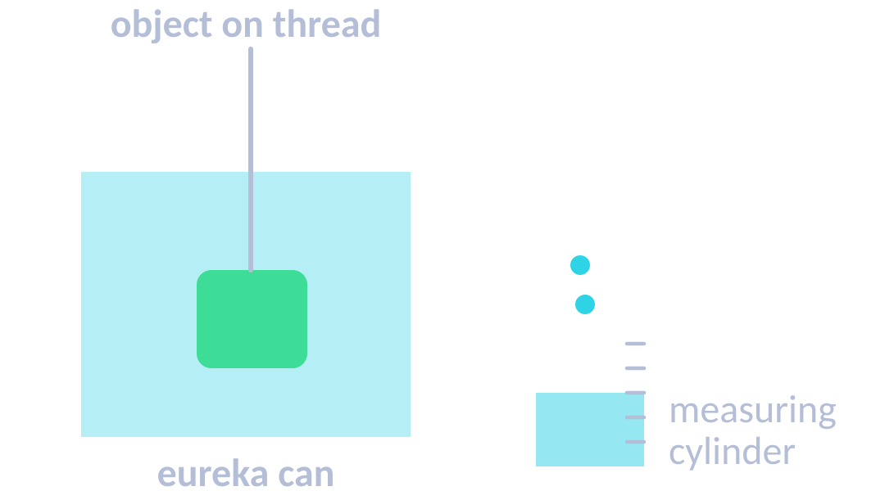
Latent heat, gas pressure & density RP
TOPIC 3 · PARTICLE MODEL OF MATTER
03
‹ INDEX
Specific latent heat
Particle motion in gases
Required practical: density
Energy needed to change the state of 1 kg of a substance without changing its temperature.
Fusion: solid ↔ liquid
Vaporisation: liquid ↔ gas
Energy for a change of state: E = m L
E in J · m in kg · L in J/kg
Condensing / freezing releases energy as bonds form.
Gas particles move in constant random motion, colliding with each other and the container walls.
These collisions produce gas pressure.
At constant volume, higher temperature → faster particles → more frequent, harder collisions → higher pressure.
Temperature is linked to the average kinetic energy of the particles.
Regular: mass on a balance; V = l × w × h.
Irregular: lower into a full eureka can; the water displaced = volume of the object.
Liquid: mass of a known volume.
Then ρ = m ÷ V.

Slide 26
Particle model worked examples
TOPIC 3 · PARTICLE MODEL OF MATTER
03
‹ INDEX
DENSITY
SPECIFIC LATENT HEAT
SPECIFIC HEAT CAPACITY
ρ = m ÷ V
E = m L
ΔE = m c Δθ
kg/m³ · kg · m³
J · kg · J/kg
J · kg · J/kg °C · °C
WORKED EXAMPLE
WORKED EXAMPLE
WORKED EXAMPLE
An object has density 8050 kg/m³ and volume 3.4 m³. Find its mass.
m = ρ × V
= 8050 × 3.4
A 50 g block measures 2 cm × 2 cm × 5 cm. Find its density in kg/m³.
m = 0.05 kg
V = 20 cm³ = 0.00002 m³
ρ = 0.05 ÷ 0.00002
0.2 kg of ice melts at 0 °C. L(fusion) = 334 000 J/kg. Find the energy needed.
E = m L
= 0.2 × 334 000
m = 27 370 kg ≈ 27 000 kg
ρ = 2500 kg/m³
E = 66 800 J

Slide 27
Examiner tips
TOPIC 3 · PARTICLE MODEL OF MATTER
03
‹ INDEX
1
Density units
2
Flat = changing state
3
SHC vs SLH
kg/m³: convert cm³ → m³ (÷ 1 000 000), or work in g/cm³ throughout.
Temperature stays constant during a change of state – energy breaks bonds instead.
Specific heat capacity → temperature change. Specific latent heat → change of state.
4
Internal energy
5
Gas pressure chain
6
Mass is conserved
Always mention both kinetic and potential energy of the particles.
Particles hit the walls → force → pressure. Hotter → faster → more frequent, harder collisions.
Changes of state are physical and reversible – no new substance forms.

Slide 28

Atomic Structure
04
‹ INDEX
IN THIS TOPIC
29 Atoms & the model of the atom
30 Isotopes & nuclear radiation
31 Nuclear decay equations
32 Half-life & contamination
Models of the atom, radiation, decay & half-life
33 Examiner tips

Slide 29



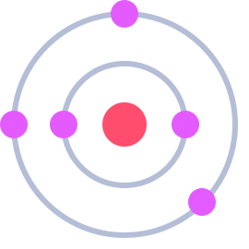

Atoms & the model of the atom
TOPIC 4 · ATOMIC STRUCTURE
04
‹ INDEX
Particle | Relative charge | Relative mass | Where
Proton | +1 | 1 | Nucleus
Neutron | 0 | 1 | Nucleus
Electron | −1 | Very small | Shells around nucleus
Key facts
Atom radius ≈ 1 × 10⁻¹⁰ m; nucleus < 1/10 000 of that.
Atoms are neutral: protons = electrons.
Atomic number = protons. Mass number = protons + neutrons.
Electrons move to higher shells by absorbing EM radiation.
Development of the model of the atom
Early 1800s
1897
1909–11
1913
1932
Dalton
Thomson
Rutherford
Bohr
Chadwick
Atoms are tiny solid spheres that cannot be divided.
Discovers the electron → plum pudding: positive ball with electrons in it.
Alpha scattering: mass & charge in a tiny nucleus; mostly empty space.
Electrons orbit in fixed shells (energy levels).
Discovers the neutron in the nucleus.

Slide 30
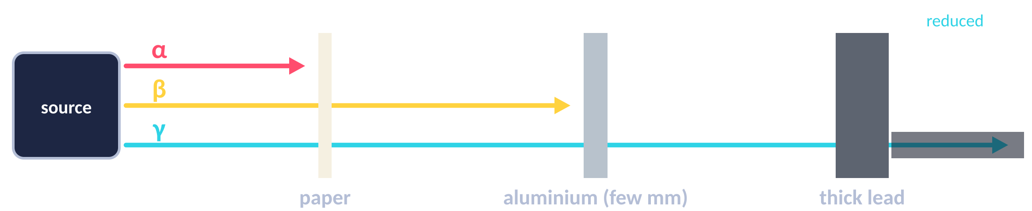
Isotopes & nuclear radiation
TOPIC 4 · ATOMIC STRUCTURE
04
‹ INDEX
 | Alpha α | Beta β | Gamma γ
What is it? | Helium nucleus (2p + 2n) | Fast electron from the nucleus | EM wave
Symbol | ⁴₂He or α | ⁰₋₁e or β | γ
Ionising power | Very high | Medium | Low
Range in air | A few cm | About 1 m | Very far
Stopped by | Paper or skin | A few mm of aluminium | Thick lead / concrete
Most dangerous | Inside the body | Outside the body | Outside the body
Isotopes
Atoms of the same element with the same number of protons but a different number of neutrons.
Same atomic number, different mass number.
Some isotopes are unstable – their nuclei decay randomly, giving out radiation.
Activity = rate of decay, in becquerels (Bq). 1 Bq = 1 decay per second.
Count rate = decays recorded per second by a Geiger–Müller tube.
¹₁H
²₁H
³₁H
hydrogen
deuterium
tritium

Slide 31
Nuclear decay equations
TOPIC 4 · ATOMIC STRUCTURE
04
‹ INDEX
Alpha decay
Beta decay
Gamma emission
²³⁸₉₂U → ²³⁴₉₀Th + ⁴₂He
¹⁴₆C → ¹⁴₇N + ⁰₋₁e
^{99m}₄₃Tc → ⁹⁹₄₃Tc + γ
Nucleus loses 2 protons + 2 neutrons.
Mass number −4, atomic number −2.
A neutron turns into a proton + electron; the electron is emitted.
Mass number same, atomic number +1.
Nucleus gets rid of excess energy as an EM wave.
No change to mass or atomic number.
WORKED EXAMPLE
WORKED EXAMPLE
Radium-226 (atomic number 88) emits an alpha particle. What is formed?
Mass: 226 − 4 = 222 Atomic: 88 − 2 = 86
Iodine-131 (atomic number 53) emits a beta particle. What is formed?
Mass: stays 131 Atomic: 53 + 1 = 54
Radon-222 (²²²₈₆Rn)
Xenon-131 (¹³¹₅₄Xe)

Slide 32
Half-life, contamination & irradiation
TOPIC 4 · ATOMIC STRUCTURE
04
‹ INDEX
Half-life
Time for the number of unstable nuclei (or the activity) to halve.
Decay is random – we can’t predict which nucleus decays next.
Contamination
Radioactive atoms get onto or into an object. Keeps irradiating until removed.
Protection: gloves, protective clothing, tongs.
WORKED EXAMPLE
A sample has activity 800 Bq and half-life 2 days. Find its activity after 6 days.
6 ÷ 2 = 3 half-lives: 800 → 400 → 200 → 100
HT: net decline = 700 Bq, ratio 700 : 800 = 7/8
Irradiation
Exposure to radiation from an outside source. The object does not become radioactive.
Protection: lead shielding, distance, limit time.
Activity = 100 Bq

Slide 33
Examiner tips
TOPIC 4 · ATOMIC STRUCTURE
04
‹ INDEX
1
Balance both numbers
2
Know the particles
3
Half-life from a graph
In decay equations the top (mass) numbers and bottom (atomic) numbers must both balance.
Alpha = ⁴₂He, beta = ⁰₋₁e. Gamma changes neither number.
Pick any activity, find when it has halved, and read the time difference.
4
Contamination ≠ irradiation
5
Evidence changes models
6
Ionising vs penetrating
Contamination: the source gets on/in you. Irradiation: exposed from outside – you don’t become radioactive.
Alpha scattering showed a tiny, dense, positive nucleus – this replaced plum pudding.
Alpha: most ionising, least penetrating. Gamma: the reverse.

Slide 34

Forces
05
‹ INDEX
IN THIS TOPIC
35 Scalars, vectors & types of force
36 Resultant forces & work done
37 Forces & elasticity
38 Speed, velocity & motion graphs
39 Acceleration & Newton’s laws
Vectors, elasticity, motion, Newton & momentum
40 Stopping distances & momentum
41 Forces equations
42 Forces worked examples (1)
43 Forces worked examples (2)
44 Examiner tips

Slide 35
Scalars, vectors & types of force
TOPIC 5 · FORCES
05
‹ INDEX
Scalar – magnitude only
Vector – magnitude + direction
Vectors are drawn as arrows: length = size, direction = direction.
Speed is the scalar size of velocity.
distance
speed
mass
displacement
velocity
force
time
energy
temperature
acceleration
weight
momentum
Contact vs non-contact
Weight
Resultant force
Contact (touching): friction, air resistance, tension, normal contact force.
Non-contact (at a distance): gravitational, electrostatic, magnetic.
W = m g (N = kg × N/kg)
Weight is the force of gravity on a mass. On Earth g ≈ 9.8 N/kg.
Acts at the centre of mass. Measured with a newtonmeter. W ∝ m.
30 N
50 N
50 − 30 = 20 N to the right → it accelerates right.
Resultant 0 N = balanced forces (equilibrium).

Slide 36
Resultant forces & work done
TOPIC 5 · FORCES
05
‹ INDEX
Forces at right angles
Work done
When a force moves an object, work is done and energy is transferred.
W = F s (J = N × m)
1 joule = work done when 1 N moves an object 1 m (1 J = 1 N m).
Work done against friction raises the temperature of the object.
Draw tip-to-tail to scale, or use Pythagoras:
R = √(100² + 100²) = 141 N
HT: a single force can be resolved into two components at right angles.
resultant
100 N
WORKED EXAMPLE
A man pushes his broken-down car with a force of 160 N for 15 m. How much work does he do?
W = F s
= 160 × 15
100 N
If forces aren’t at 90°, use a scale drawing (parallelogram of forces) and measure the diagonal.
W = 2400 J

Slide 37
Forces & elasticity
TOPIC 5 · FORCES
05
‹ INDEX
Force–extension graph
Elastic vs inelastic deformation
force (N)
More than one force is needed to stretch, squash or bend an object.
Elastic: returns to its original shape when the force is removed.
Inelastic: permanently deformed – does not return.
limit of proportionality
Required practical: force & extension
extension (m)
1. Hang a spring from a clamp next to a vertical ruler; record its original length.
2. Add masses one at a time; record the new length each time.
3. Extension = new length − original length. Weight = m × 9.8.
4. Plot force (y) against extension (x). Gradient = k.
Work done stretching = elastic PE stored: E_{e} = ½ k e².
Hooke’s law: F = k e
Extension ∝ force up to the limit of proportionality. Gradient = spring constant k (N/m).

Slide 38
Speed, velocity & motion graphs
TOPIC 5 · FORCES
05
‹ INDEX
1.5
3
6
13–30
250
330
walking (m/s)
running (m/s)
cycling (m/s)
car (m/s)
aircraft (m/s)
sound in air (m/s)
Key ideas
Distance–time
Velocity–time
Distance (scalar) – how far. Displacement (vector) – straight line from start to end, with direction.
Speed: s = v t, so v = s ÷ t (s = distance).
Velocity: speed in a given direction. Moving in a circle at constant speed means velocity is changing.
distance
velocity
time
time
Gradient = speed
Flat line = stationary
Curve = changing speed (HT: tangent)
Gradient = acceleration
Flat line = constant velocity
HT: area under = distance

Slide 39
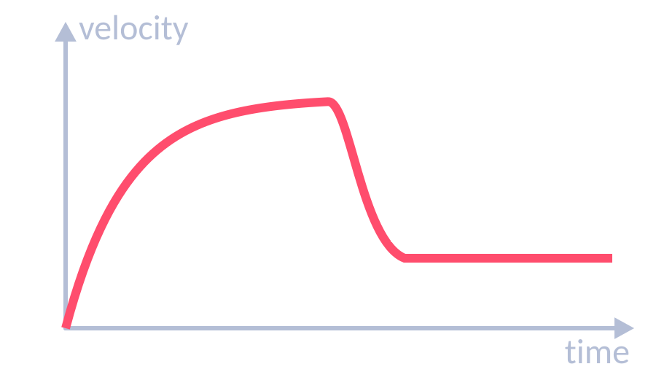
Acceleration & Newton’s laws
TOPIC 5 · FORCES
05
‹ INDEX
1st law
2nd law
3rd law
If the resultant force is zero, a stationary object stays still and a moving object keeps the same speed and direction.
Acceleration ∝ resultant force and inversely ∝ mass: F = m a. Inertial mass = F ÷ a.
When two objects interact, they exert equal and opposite forces on each other (same type of force).
Acceleration
Terminal velocity
Required practical: F = ma
a = Δv ÷ t (m/s²)
v² − u² = 2 a s
Free fall: a ≈ 9.8 m/s².
Deceleration = negative acceleration.
Weight > drag → accelerates.
Drag rises with speed until drag = weight → terminal velocity.
Parachute → more drag → lower terminal velocity.
Trolley pulled by hanging masses; light gates measure acceleration.
Vary force (keep total mass constant) or vary mass.
Result: a ∝ F; a ∝ 1/m.

Slide 40
Stopping distances & momentum
TOPIC 5 · FORCES
05
‹ INDEX
Braking
Friction between brakes and wheel does work, transferring kinetic energy to thermal energy in the brakes.
Higher speed → bigger braking force needed → large deceleration can overheat brakes.
Reaction time: measure with the ruler-drop test.
Momentum (HT)
p = m v (kg m/s = kg × m/s)
Conservation of momentum: in a closed system, total momentum before = total momentum after an event (collision or explosion).
Stopping distance = thinking + braking
Thinking ↑ with speed, tiredness, drugs, alcohol, distractions (reaction time 0.2–0.9 s).
Braking ↑ with speed, wet/icy roads, worn brakes or tyres.

Slide 41
Forces equations
TOPIC 5 · FORCES
05
‹ INDEX
WEIGHT
EX › 42
RESULTANT FORCE
EX › 42
WORK DONE
EX › 36
HOOKE’S LAW
EX › 42
SPEED
EX › 42
W = m g
F = m a
W = F s
F = k e
s = v t
N · kg · N/kg
N · kg · m/s²
J · N · m
N · N/m · m
s (distance) in m · m/s · s
ACCELERATION
EX › 43
UNIFORM ACCELERATION
EX › 43
ELASTIC PE
EX › 42
MOMENTUM (HT)
EX › 43
CONVERT FIRST!
a = Δv ÷ t
v² − u² = 2 a s
E_{e} = ½ k e²
p = m v
km→m ×1000
m/s² · m/s · s
m/s · m/s² · m
J · N/m · m
kg m/s · kg · m/s
min→s ×60 · g→kg ÷1000 · cm→m ÷100

Slide 42
Forces worked examples (1)
TOPIC 5 · FORCES
05
‹ INDEX
WORKED EXAMPLE
WORKED EXAMPLE
WORKED EXAMPLE
Find the weight of a 60 kg student on Earth (g = 9.8 N/kg).
W = m g
= 60 × 9.8
A 1200 kg car accelerates at 2.5 m/s². Find the resultant force.
F = m a
= 1200 × 2.5
A spring stretches 0.04 m under a 2 N force. Find k.
k = F ÷ e
= 2 ÷ 0.04
W = 588 N
F = 3000 N
k = 50 N/m
WORKED EXAMPLE
WORKED EXAMPLE
WORKED EXAMPLE
A bungee cord holding an 800 N jumper stretches 25 m. Find the elastic PE stored.
k = F ÷ e = 800 ÷ 25 = 32 N/m
E_{e} = ½ × 32 × 25²
John runs 5 km in 25 minutes. Find his average speed in m/s.
s = 5000 m, t = 25 × 60 = 1500 s
v = s ÷ t = 5000 ÷ 1500
A car travels 15 miles at an average 65 mph. How long does it take, in minutes?
t = s ÷ v = 15 ÷ 65 = 0.23 h
0.23 × 60
E_{e} = 10 000 J
v = 3.3 m/s
t ≈ 14 minutes

Slide 43
Forces worked examples (2)
TOPIC 5 · FORCES
05
‹ INDEX
WORKED EXAMPLE
WORKED EXAMPLE
WORKED EXAMPLE
A dog reaches 4 m/s from rest in 16 s. Find its acceleration.
a = Δv ÷ t
= (4 − 0) ÷ 16
A bus at 2 m/s accelerates at 1.5 m/s² over 50 m. Find its final velocity.
v² = u² + 2 a s
= 2² + (2 × 1.5 × 50) = 154
v = √154
A driver at 20 m/s has a reaction time of 0.7 s. Braking distance is 30 m. Find the stopping distance.
thinking = 20 × 0.7 = 14 m
stopping = 14 + 30
a = 0.25 m/s²
v = 12.4 m/s
Stopping = 44 m
WORKED EXAMPLE
WORKED EXAMPLE
WORKED EXAMPLE
HT: An 85 kg cyclist travels at 12 m/s. Find their momentum.
p = m v
= 85 × 12
HT: A 2 kg trolley at 3 m/s hits a stationary 1 kg trolley; they stick together. Find their velocity.
p before = 2 × 3 = 6 kg m/s
v = 6 ÷ (2 + 1)
A crate is pushed with 50 N right; friction is 35 N left. Find the resultant force.
Forces in a line: subtract
50 − 35 = 15
p = 1020 kg m/s
v = 2 m/s
F = 15 N to the right

Slide 44
Examiner tips
TOPIC 5 · FORCES
05
‹ INDEX
1
Free-body diagrams
2
Mass ≠ weight
3
Read the graph
Draw arrows from the object, to scale, and label each force.
Mass in kg; weight is a force in N. W = m g.
Gradient of d–t = speed; gradient of v–t = acceleration; HT: area under v–t = distance.
4
v² − u² = 2as
5
Stopping distance
6
Momentum has direction
Square the speeds, rearrange, then take the square root at the end.
Thinking distance → driver factors. Braking distance → car & road factors. Don’t mix them.
Give opposite velocities opposite signs (+/−) before adding momenta.

Slide 45

Waves
06
‹ INDEX
IN THIS TOPIC
46 Wave types & properties
47 Measuring waves
48 The electromagnetic spectrum
49 Refraction & infrared radiation
Wave properties, EM spectrum & refraction
50 Equations & worked examples
51 Examiner tips

Slide 46
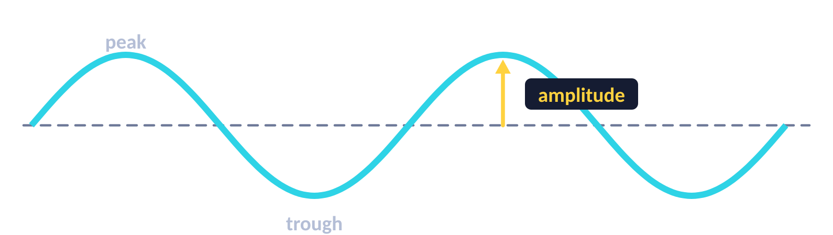

Transverse & longitudinal waves
TOPIC 6 · WAVES
06
‹ INDEX
Transverse
Longitudinal
Vibrations are parallel to the direction of energy transfer, e.g. sound waves.
Compression: particles squashed close together (higher pressure).
Rarefaction: particles spread further apart (lower pressure).
Vibrations are perpendicular to the direction of energy transfer. E.g. water ripples, all EM waves.
Amplitude
Wavelength λ
Frequency f
Period T
Wave speed v
Max displacement from rest position to a peak or trough (m)
Distance from one point to the same point on the next wave (m)
Number of waves passing a point each second (Hz)
Time for one wave to pass: T = 1 ÷ f (s)
Speed energy is transferred: v = f λ (m/s)

Slide 47
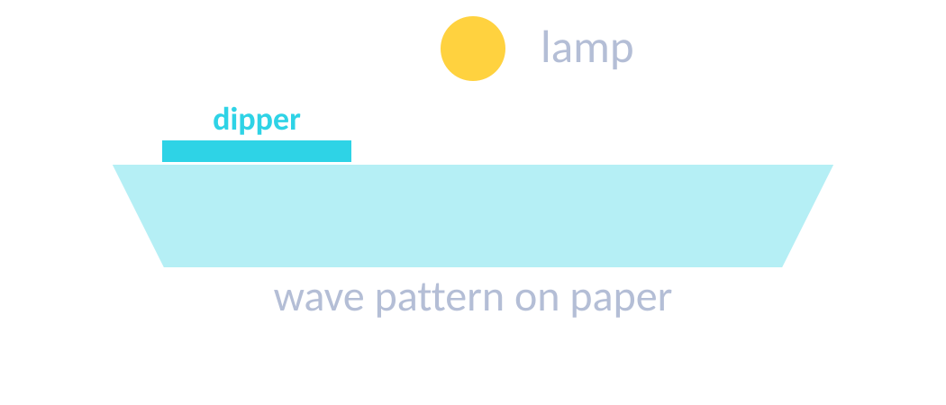
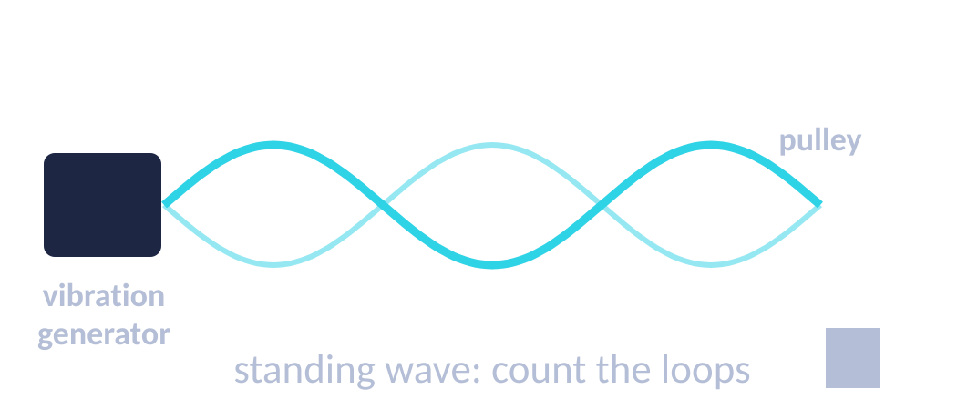
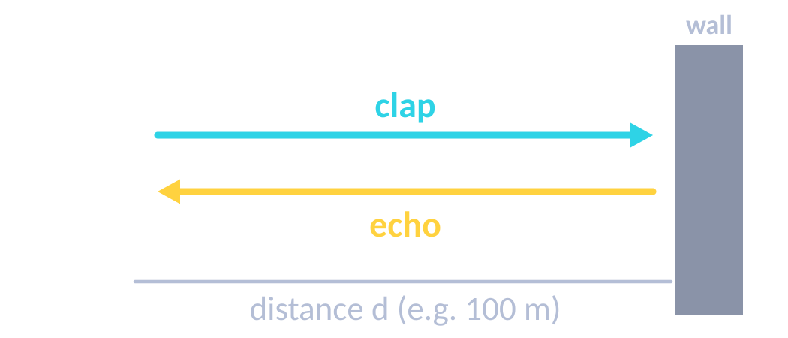
Measuring waves
TOPIC 6 · WAVES
06
‹ INDEX
Ripple tank (RP)
Waves on a string (RP)
Speed of sound (echo)
1. Adjust the signal generator until waves are clear (low frequency is easier).
2. λ: measure across 10 waves and ÷ 10 (a strobe can freeze the pattern).
3. f: count waves passing a point in 10 s and ÷ 10.
4. v = f λ
1. Adjust the frequency until a clear standing wave appears.
2. λ: measure several loops – each loop is ½ λ.
3. f = the signal generator setting.
4. v = f λ
1. Stand a measured distance from a large wall (e.g. 100 m).
2. Clap and time how long until you hear the echo.
3. Sound goes there and back: distance = 2d.
4. speed = 2d ÷ time. Repeat and average.

Slide 48
The electromagnetic spectrum
TOPIC 6 · WAVES
06
‹ INDEX
Radio
Microwave
Infrared
Visible
Ultraviolet
X-ray
Gamma
USES
USES
USES
USES
USES
USES
USES
TV & radio
Satellites, cooking
Heaters, thermal cameras, remotes
Fibre optics, seeing
Tanning, energy-efficient lamps, security marks
Medical imaging, airport security
Sterilising, cancer treatment
HAZARD
HAZARD
HAZARD
HAZARD
HAZARD
HAZARD
HAZARD
Low risk
Internal heating
Skin burns
Bright light can damage eyes
Skin cancer, ageing
Mutations → cancer
Mutations → cancer
increasing frequency & energy · decreasing wavelength →
Remember:
Roman Men Invented Very Unusual X-ray Guns
All EM waves
Transverse; travel at the same speed in a vacuum; transfer energy from source to absorber.

Slide 49
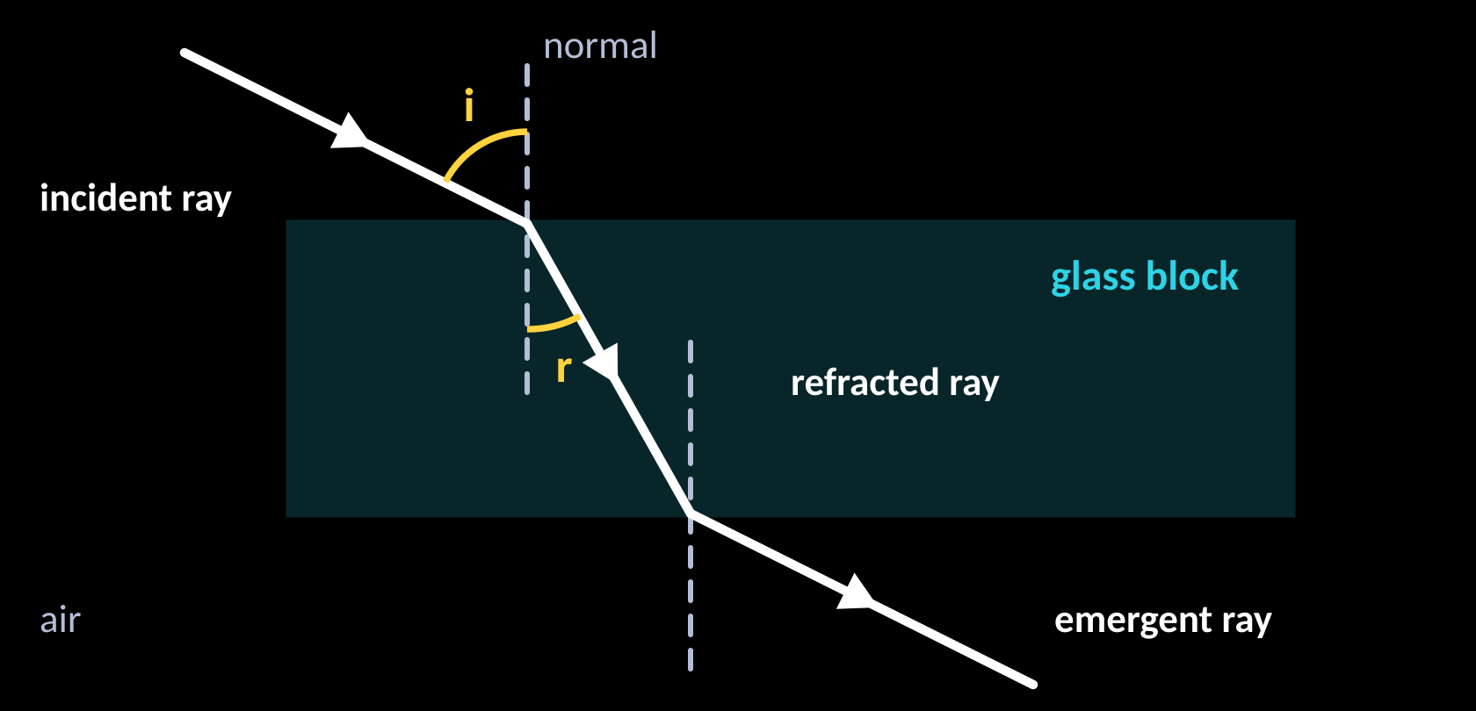
Refraction & infrared radiation
TOPIC 6 · WAVES
06
‹ INDEX
Refraction through a glass block
Absorbing & emitting infrared
All objects emit and absorb infrared. Hotter objects emit more.
Dark, matt surfaces are the best absorbers and emitters.
Light, shiny surfaces are the worst – they reflect infrared.
Required practical: Leslie cube
Into a denser medium: wave slows down and bends towards the normal.
Out of it: speeds up and bends away from the normal.
Along the normal (90° to surface): speed changes, no change of direction.
HT: wavelength changes, frequency stays the same.
1. Fill a Leslie cube with hot water from a kettle; replace the lid.
2. Use an infrared detector at the same distance from each face.
3. Record the reading for each surface (black matt, white, shiny…).
Result: black matt emits the most infrared radiation.

Slide 50
Waves equations & worked examples
TOPIC 6 · WAVES
06
‹ INDEX
WAVE SPEED
PERIOD
SPEED (ECHO)
v = f λ
T = 1 ÷ f
s = v t
m/s · Hz · m
s · Hz
remember: s = 2 × distance to wall
WORKED EXAMPLE
WORKED EXAMPLE
Ripples have frequency 5 Hz and wavelength 0.02 m. Find their speed.
v = f λ = 5 × 0.02
A radio wave (v = 3 × 10⁸ m/s) has f = 100 MHz. Find λ.
λ = v ÷ f = 300 000 000 ÷ 100 000 000
v = 0.1 m/s
λ = 3 m
WORKED EXAMPLE
WORKED EXAMPLE
A clap echoes off a wall 100 m away after 0.6 s. Find the speed of sound.
s = 2 × 100 = 200 m; v = s ÷ t = 200 ÷ 0.6
A wave has frequency 0.25 Hz. Find its period.
T = 1 ÷ f = 1 ÷ 0.25
v = 333 m/s
T = 4 s

Slide 51
Examiner tips
TOPIC 6 · WAVES
06
‹ INDEX
1
Measure many waves
2
Echo = double distance
3
Refraction
Measure across several waves and divide – this reduces uncertainty.
The sound goes there and back – double the distance to the wall.
Speed and wavelength change; frequency doesn’t. Slower → bends towards the normal.
4
EM spectrum order
5
Standard form
6
Describe the wave type
Radio → gamma (“Roman Men Invented…”). Learn one use and one hazard for each.
3 × 10⁸ m/s; MHz = × 10⁶; kHz = × 10³.
Say how the oscillations move relative to the direction of energy transfer.

Slide 52

Magnetism & Electromagnetism
07
‹ INDEX
IN THIS TOPIC
53 Magnets & magnetic fields
54 Electromagnetism
55 The motor effect
56 Examiner tips
Fields, solenoids & the motor effect

Slide 53
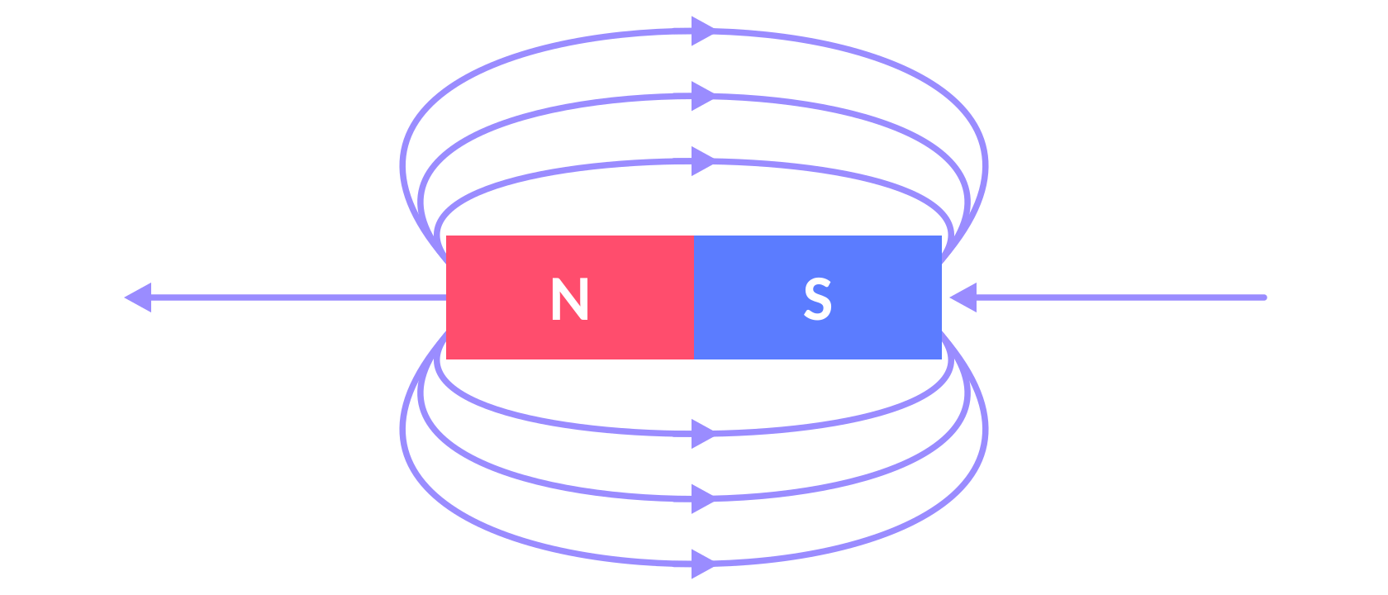
Magnets & magnetic fields
TOPIC 7 · MAGNETISM & ELECTROMAGNETISM
07
‹ INDEX
Permanent vs induced magnets
Permanent: produces its own magnetic field all the time (e.g. bar magnet).
Induced: becomes magnetic only when in a magnetic field; loses most/all magnetism when removed. Induced magnetism always attracts.
Field lines go from N to S. Closer lines = stronger field.
Plotting field lines & the Earth
1. Place a bar magnet on paper; put a plotting compass near it.
2. Mark where the needle points; move the compass to that dot and repeat.
3. Join the dots and add arrows (N → S).
A compass points north because the Earth’s core is magnetic – evidence the Earth has a magnetic field.
Poles
Like poles repel (N–N, S–S). Opposite poles attract (N–S).
Magnetic force is a non-contact force, strongest at the poles.
Magnetic materials: iron, steel, cobalt, nickel.

Slide 54
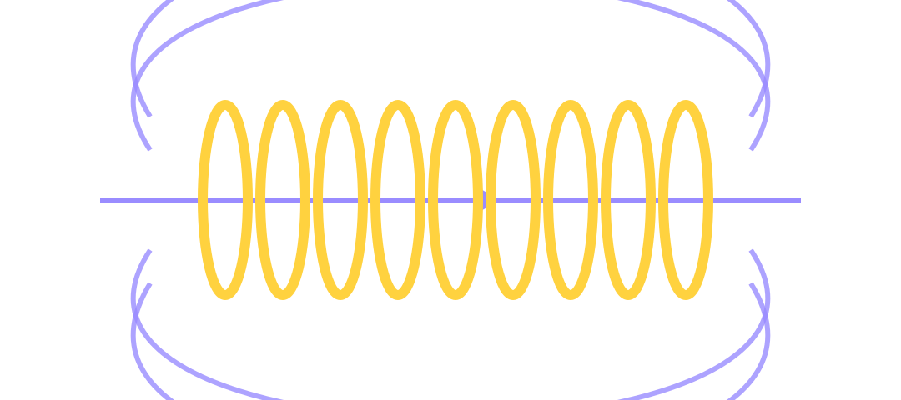
Electromagnetism
TOPIC 7 · MAGNETISM & ELECTROMAGNETISM
07
‹ INDEX
Current in a wire
Solenoid
Make it stronger
Add an iron core
More turns on the coil
Bigger current
Field inside is strong & uniform; outside it looks like a bar magnet’s field.
Add an iron core → electromagnet.
Concentric circles round the wire. Stronger with more current and closer to the wire.
Uses of electromagnets
Electric motors · loudspeakers · electric bells · scrapyard cranes · relays · remotely controlled door locks. The key advantage: the magnetism can be switched on and off and its strength changed.

Slide 55
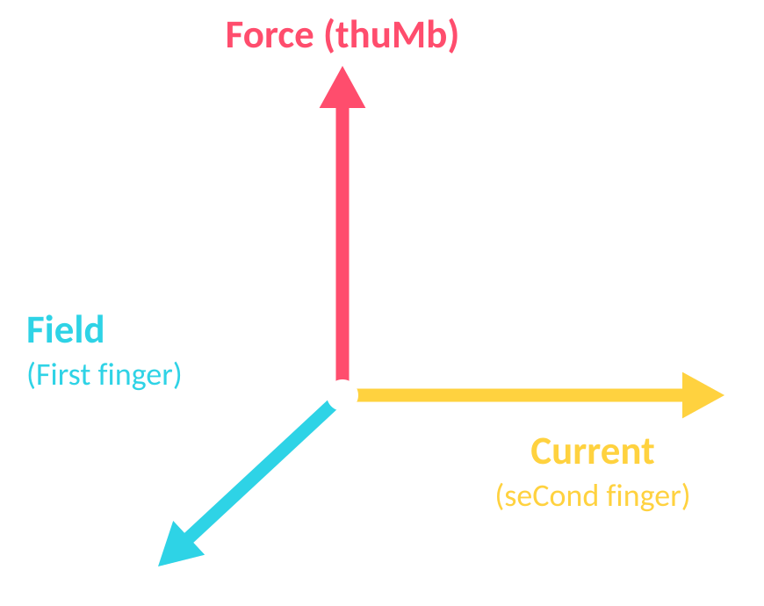
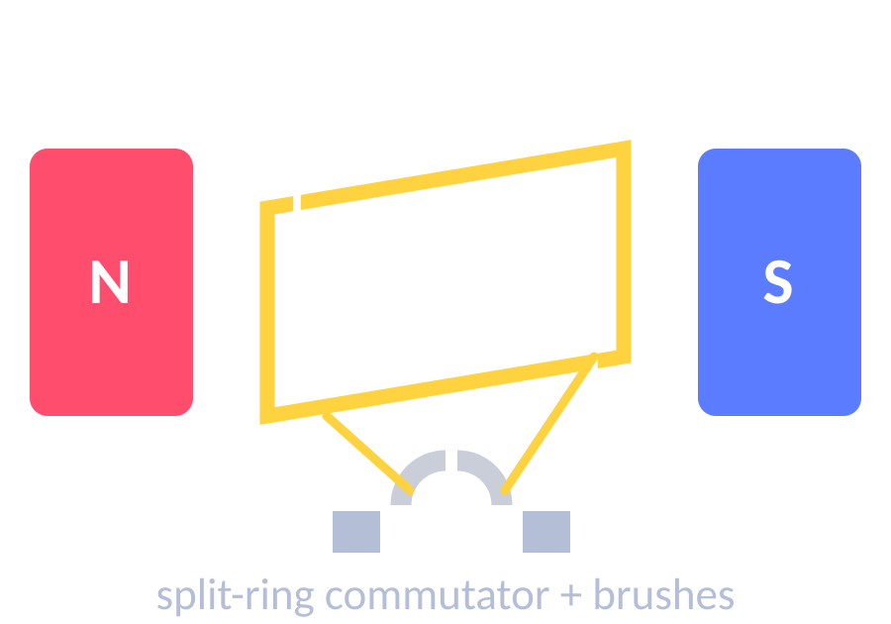
The motor effect
HIGHER TIER
TOPIC 7 · MAGNETISM & ELECTROMAGNETISM
07
‹ INDEX
Fleming’s left-hand rule
FORCE ON A CONDUCTOR (HT)
F = B I l
Thumb
Force / motion
F in N · B (magnetic flux density) in T · I in A · l in m
First finger
Field (N → S)
Second finger
Current (+ → −)
WORKED EXAMPLE
8 A flows in a 75 cm wire at right angles to a 0.5 T field. Find the force.
l = 0.75 m; F = 0.5 × 8 × 0.75
Electric motor
F = 3 N
Forces on each side act in opposite directions → the coil turns.
A split-ring commutator reverses the current every half turn.
No force if the wire is parallel to the field.
WORKED EXAMPLE
A 0.1 m wire in a 0.2 T field feels 0.06 N. Find the current.
I = F ÷ (B l) = 0.06 ÷ (0.2 × 0.1)
I = 3 A

Slide 56
Examiner tips
TOPIC 7 · MAGNETISM & ELECTROMAGNETISM
07
‹ INDEX
1
Field-line rules
2
Left-hand rule
3
F = B I l
Lines go N → S, never cross, and are closest where the field is strongest.
First finger = Field, seCond finger = Current, thuMb = Motion (force).
Convert cm → m first. It only applies when the wire is at 90° to the field.
4
Stronger electromagnet
5
Induced magnets
6
Explain the motor
More turns, bigger current, add an iron core.
Induced magnetism always attracts – only permanent magnets can repel.
Forces on opposite sides act in opposite directions; the commutator reverses the current every half turn.

Slide 57

Equation Bank
08
‹ INDEX
IN THIS TOPIC
58 All equations by topic
59 Equation sheet, units & prefixes
Every equation, units & prefixes

Slide 58
Equations by topic
EQUATION BANK
08
‹ INDEX
The equation sheet is provided in the exam and all of these are on it – your job is to pick the right one, rearrange it and use SI units.
01
Energy
02
Electricity
05
Forces
03
Particles
E_{k} = ½ m v²
Q = I t
W = m g
ρ = m ÷ V
E_{p} = m g h
V = I R
F = m a
E = m L
E_{e} = ½ k e²
P = V I
W = F s
06
Waves
ΔE = m c Δθ
P = I² R
F = k e
v = f λ
P = E ÷ t
E = P t
s = v t
T = 1 ÷ f
P = W ÷ t
E = Q V
a = Δv ÷ t
07
Magnetism
efficiency = useful ÷ total
v² − u² = 2 a s
F = B I l (HT)
p = m v (HT)

Slide 59
Using the equation sheet, units & prefixes
EQUATION BANK
08
‹ INDEX
How to answer a calculation question
Quantity | Unit | Symbol
Energy / work | joule | J
Power | watt | W
Force / weight | newton | N
Charge | coulomb | C
Current | ampere | A
Potential difference | volt | V
Resistance | ohm | Ω
Frequency | hertz | Hz
Activity | becquerel | Bq
Flux density | tesla | T
Prefix | ×
giga (G) | 10⁹
mega (M) | 10⁶
kilo (k) | 10³
centi (c) | 10⁻²
milli (m) | 10⁻³
micro (µ) | 10⁻⁶
nano (n) | 10⁻⁹
1
List the values Write each value with its unit. Convert to SI: g → kg, cm → m, kJ → J, minutes → s.
2
Choose the equation Find the one on the sheet that links what you know to what you want – knowing the common ones by heart saves time.
3
Rearrange Rearrange first, or substitute then rearrange – show it either way.
4
Calculate Keep the full calculator value until the end.
5
Unit & sig figs Give the unit and round to the same number of significant figures as the least precise data value.
6
Sense-check Is the size sensible? (A person can’t run at 300 m/s!)

