Slide 1








01 Energy
AQA GCSE PHYSICS · SEPARATE SCIENCE
02 Electricity
PHYSICS
03 Particle Model of Matter
04 Atomic Structure
Knowledge Organiser
05 Forces
All 8 topics · key facts · diagrams · every equation with worked examples · required practicals · examiner tips
Foundation & Higher tier · ★ marks physics-only content
06 Waves
07 Magnetism & Electromagnetism
OPEN THE INDEX ›
08 Space Physics

Slide 2


Index
CLICK ANY TOPIC OR PAGE TO JUMP STRAIGHT TO IT · ★ = PHYSICS ONLY
01
02
03
04
05
Energy
Electricity
Particle Model
Atomic Structure
Forces
4 Energy stores & systems
13 Current, p.d. & resistance
24 States of matter & density
31 Atoms & atomic models
39 Scalars, vectors & forces
5 Equations
14 Circuit symbols & sensors
25 Internal energy & state
32 Isotopes & radiation
40 Resultants & work done
6 Worked examples (1)
15 Series & parallel circuits
26 Latent heat & gas pressure
33 Nuclear decay equations
41 Forces & elasticity
16 Mains & the National Grid
42 Speed & motion graphs
7 Worked examples (2)
27 Gas pressure & volume ★
34 Half-life & contamination
43 Newton’s laws
8 Efficiency & Sankey diagrams
17 Static & electric fields ★
28 Worked examples
35 Background & uses ★
44 Stopping & momentum
9 Wasted energy & SHC practical
18 Equations
29 Examiner tips
36 Fission & fusion ★
45 Moments, levers & gears ★
19 Worked examples (1)
46 Pressure in fluids ★
10 Energy resources
37 Examiner tips
47 Momentum & safety ★
11 Examiner tips
20 Worked examples (2)
48 Equations
21 Required practicals
49 Worked examples (1)
22 Examiner tips
50 Worked examples (2)
51 Examiner tips
06
07
08
09
★
Waves
Magnetism & EM
Space Physics
Equation Bank
53 Wave types & properties
63 Magnets & magnetic fields
70 Life cycle of stars ★
74 All equations by topic
Physics only
Separate Science content that is not in Combined Science.
54 Measuring waves
64 Electromagnetism
71 Orbits & the Big Bang ★
75 Equation sheet & units
55 EM spectrum
65 The motor effect
72 Examiner tips
56 Refraction & infrared
57 Sound & seismic waves ★
66 Generator effect ★
58 Lenses & visible light ★
67 Transformers ★
59 Black body & light RP ★
68 Examiner tips
60 Equations & examples
61 Examiner tips

Slide 3

Energy
01
‹ INDEX
IN THIS TOPIC
4 Energy stores & systems
5 Energy equations
6 Energy worked examples (1)
7 Energy worked examples (2)
Stores, transfers, power, efficiency & resources
8 Efficiency & Sankey diagrams
9 Wasted energy & SHC practical
10 Energy resources
11 Examiner tips

Slide 4








Energy stores & systems
TOPIC 1 · ENERGY
01
‹ INDEX
Conservation of energy
Kinetic
Thermal
Chemical
Elastic potential
Energy can never be created or destroyed – only transferred, stored or dissipated.
Some energy is transferred usefully; the rest is wasted – usually dissipated to the surroundings as thermal energy.
Anything moving
All objects – hotter = more
Fuels, food, batteries
Stretched / squashed
Gravitational PE
Electrostatic
Magnetic
Nuclear
Anything raised up
Charges attract / repel
Magnets attract / repel
Released from the nucleus
Four ways energy is transferred
Systems
1
2
3
4
A system is an object or group of objects.
When a system changes, energy moves between stores.
Closed system: no energy in or out, so no net change in total energy.
Mechanically
Electrically
By heating
By radiation
A force does work, e.g. pushing, stretching
Moving charge does work, e.g. a current
Hotter object → cooler object
Waves, e.g. light, infrared, sound

Slide 5
Energy equations
TOPIC 1 · ENERGY
01
‹ INDEX
KINETIC ENERGY
EXAMPLE › 6
GRAVITATIONAL PE
EXAMPLE › 6
ELASTIC PE
EXAMPLE › 7
SPECIFIC HEAT CAPACITY
EXAMPLE › 6
E_{k} = ½ m v²
E_{p} = m g h
E_{e} = ½ k e²
ΔE = m c Δθ
E_{k} in J · m in kg · v in m/s
J · kg · g in N/kg · h in m
J · k in N/m · e (extension) in m
J · kg · c in J/kg °C · Δθ in °C
POWER (ENERGY)
EXAMPLE › 7
POWER (WORK)
EXAMPLE › 7
EFFICIENCY (ENERGY)
EXAMPLE › 8
EFFICIENCY (POWER)
EXAMPLE › 8
P = E ÷ t
P = W ÷ t
useful energy out ÷ total energy in
useful power out ÷ total power in
P in W · E in J · t in s
P in W · W (work done) in J · t in s
× 100 for a percentage
× 100 for a percentage

Slide 6
Energy worked examples (1)
TOPIC 1 · ENERGY
01
‹ INDEX
WORKED EXAMPLE
WORKED EXAMPLE
A 1200 kg car travels at 15 m/s. Calculate its kinetic energy.
E_{k} = ½ m v²
= 0.5 × 1200 × 15²
= 0.5 × 1200 × 225
A 2 kg bag is lifted 5 m onto a shelf (g = 9.8 N/kg). Find the gain in GPE.
E_{p} = m g h
= 2 × 9.8 × 5
E_{k} = 135 000 J
E_{p} = 98 J
WORKED EXAMPLE
WORKED EXAMPLE
0.5 kg of water is heated from 20 °C to 40 °C (c = 4200 J/kg °C). How much energy is needed?
Δθ = 40 − 20 = 20 °C
ΔE = m c Δθ = 0.5 × 4200 × 20
A motor is supplied with 500 J and transfers 150 J usefully. Calculate its efficiency.
efficiency = useful out ÷ total in
= 150 ÷ 500 = 0.30
ΔE = 42 000 J
Efficiency = 0.30 = 30%

Slide 7
Energy worked examples (2)
TOPIC 1 · ENERGY
01
‹ INDEX
WORKED EXAMPLE
WORKED EXAMPLE
WORKED EXAMPLE
A spring (k = 40 N/m) is stretched by 0.05 m. Find the elastic potential energy stored.
E_{e} = ½ k e²
= 0.5 × 40 × 0.05²
= 0.5 × 40 × 0.0025
A kettle transfers 180 000 J in 1 minute. Find its power.
t = 60 s
P = E ÷ t = 180 000 ÷ 60
A crane does 24 000 J of work lifting a load in 12 s. Find its power.
P = W ÷ t
= 24 000 ÷ 12
E_{e} = 0.05 J
P = 3000 W
P = 2000 W
WORKED EXAMPLE
WORKED EXAMPLE
WORKED EXAMPLE
A 0.5 kg ball gains 20 J of GPE (g = 9.8 N/kg). How high was it lifted?
h = E_{p} ÷ (m g)
= 20 ÷ (0.5 × 9.8)
A ball is dropped from 5 m. Ignoring air resistance, find its landing speed (g = 9.8 N/kg).
GPE lost = KE gained: m g h = ½ m v²
v = √(2 g h) = √(2 × 9.8 × 5)
36 000 J warms 2 kg of a metal by 10 °C. Find its specific heat capacity.
c = ΔE ÷ (m Δθ)
= 36 000 ÷ (2 × 10)
h = 4.1 m
v = 9.9 m/s
c = 1800 J/kg °C

Slide 8
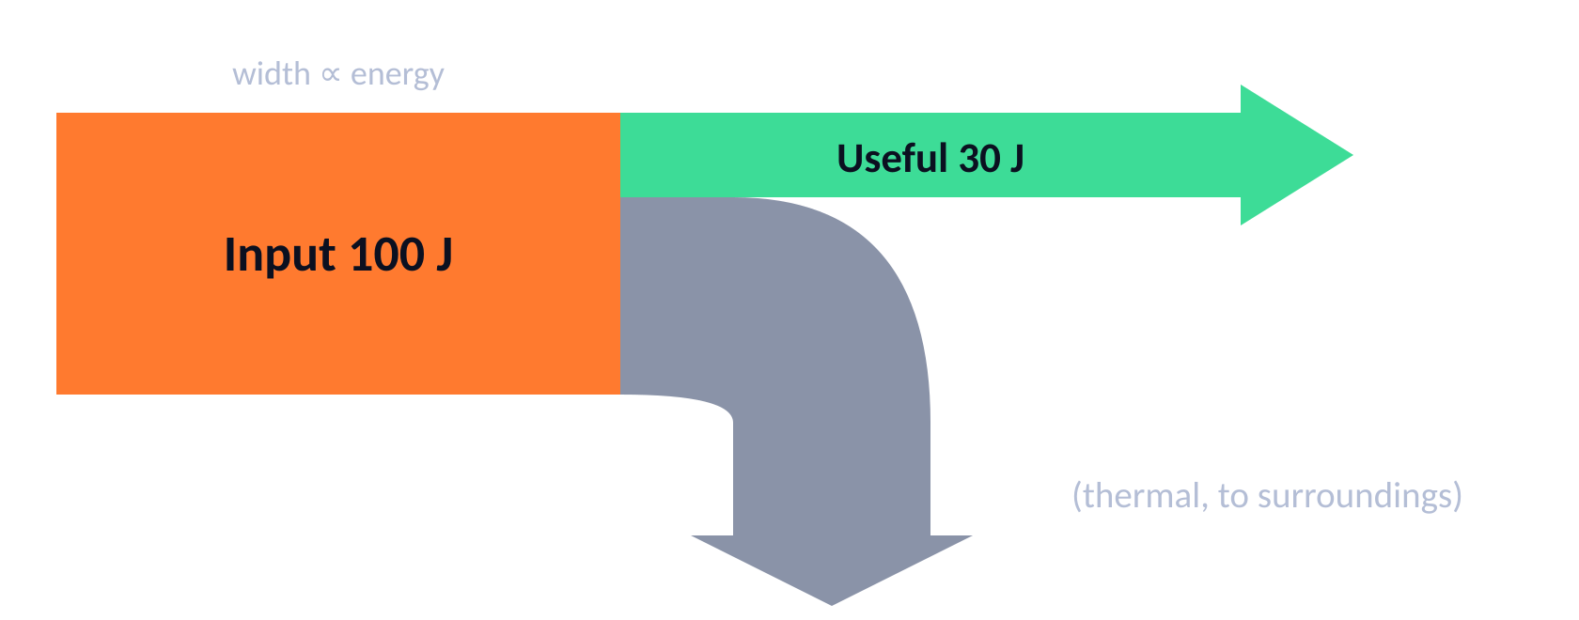
Efficiency & Sankey diagrams
TOPIC 1 · ENERGY
01
‹ INDEX
Sankey diagram
WORKED EXAMPLE
A motor is supplied with 400 W; its useful output is 300 W. Find its efficiency.
300 ÷ 400 = 0.75
Efficiency = 75%
WORKED EXAMPLE
A 60% efficient bulb is supplied with 500 J. Find the useful energy output.
useful = 0.6 × 500
Useful = 300 J
Efficiency
efficiency = useful output ÷ total input (energy or power).
× 100 for a percentage. No units; never more than 1 (100%).
Improve it: lubricate moving parts, insulate to cut heat loss.
WORKED EXAMPLE
A 1200 W heater is 90% efficient. How much power is wasted?
useful = 0.9 × 1200 = 1080 W; wasted = 1200 − 1080
Wasted = 120 W

Slide 9
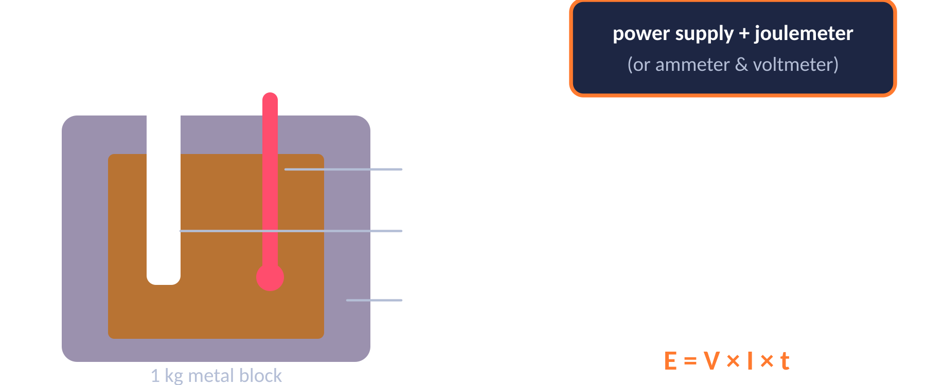
Wasted energy & specific heat capacity
TOPIC 1 · ENERGY
01
‹ INDEX
Required practical: specific heat capacity
Reducing unwanted energy transfers
Method
Lubrication (e.g. oil) reduces friction between moving parts.
Thermal insulation: loft insulation, cavity walls, double glazing, thick walls.
Materials with low thermal conductivity transfer energy more slowly.
Thicker walls → slower rate of cooling.
IV: material DV: temperature rise CV: mass, insulation, p.d.
1. Record V and I; read the temperature every minute for 10 minutes.
2. Energy E = V × I × t. Plot temperature (y) against energy (x).
3. c = 1 ÷ (gradient × mass). Insulation reduces heat loss.

Slide 10
Energy resources
TOPIC 1 · ENERGY
01
‹ INDEX
Resource | Type | Advantages | Disadvantages
Fossil fuels | Non-renewable | Reliable; large output; can meet changing demand | Running out; CO₂ → global warming; SO₂ → acid rain
Nuclear | Non-renewable | Reliable; no CO₂; huge energy from little fuel | Radioactive waste; expensive to build & decommission
Biofuels | Renewable | Reliable; “carbon neutral” | Land use; forests cleared to grow crops
Wind | Renewable | No pollution; low running cost | Unreliable – no wind, no power; noisy / visual impact
Hydroelectric | Renewable | No pollution; supply can be increased quickly | Flooding destroys habitats
Geothermal | Renewable | Reliable – rocks always hot; small impact | Only in volcanic areas; may release gases
Tidal | Renewable | Very reliable & predictable; no pollution | Alters estuary habitats; fish harmed
Waves | Renewable | No pollution | Unreliable; disturbs seabed habitats
Solar | Renewable | No pollution; reliable in sunny places | Only works in daylight; can’t increase supply
Trends
Renewables now generate around half of UK electricity; gas and nuclear supply most of the rest. Barriers to more renewables: cost of new plants, public opposition to local sites, and higher bills.

Slide 11
Examiner tips
TOPIC 1 · ENERGY
01
‹ INDEX
1
Show every step
2
Square only the speed
3
Convert units first
Write the equation, substitute, then calculate – method marks are given even if the final answer is wrong.
In E_{k} = ½ m v², square v first, then multiply by m and ½.
g → kg (÷ 1000), kJ → J (× 1000), minutes → s (× 60).
4
Δθ is a change
5
Efficiency sense-check
6
Use stores & pathways
Temperature change = final − start. Don’t use the final temperature.
No units, and never more than 1 (100%). If yours is bigger, you’ve divided the wrong way.
Say “chemical store → thermal store, by heating” – avoid “heat energy” or “movement energy”.

Slide 12

Electricity
02
‹ INDEX
IN THIS TOPIC
13 Current, p.d. & resistance
14 Circuit symbols, LDRs & thermistors
15 Series & parallel circuits
16 Mains & the National Grid
17 Static & electric fields ★
Circuits, mains, the National Grid & static
18 Electricity equations
19 Electricity worked examples (1)
20 Electricity worked examples (2)
21 Required practicals
22 Examiner tips

Slide 13
Current, potential difference & resistance
TOPIC 2 · ELECTRICITY
02
‹ INDEX
I–V characteristics
Current (I) · amps, A
Rate of flow of charge. Only flows in a complete circuit.
Same at every point in a single loop.
Ohmic conductor
Filament lamp
Diode
I
I
I
Potential difference (V) · volts, V
V
V
V
The “push” – energy transferred per unit charge.
Measured with a voltmeter in parallel.
Straight line through origin: I ∝ V at constant temperature. R is constant.
Curve flattens: filament heats up, so resistance increases.
Current flows one way only – very high resistance in reverse.
Resistance (R) · ohms, Ω
Opposes the current. V = I R
Higher R → smaller current for the same p.d.

Slide 14
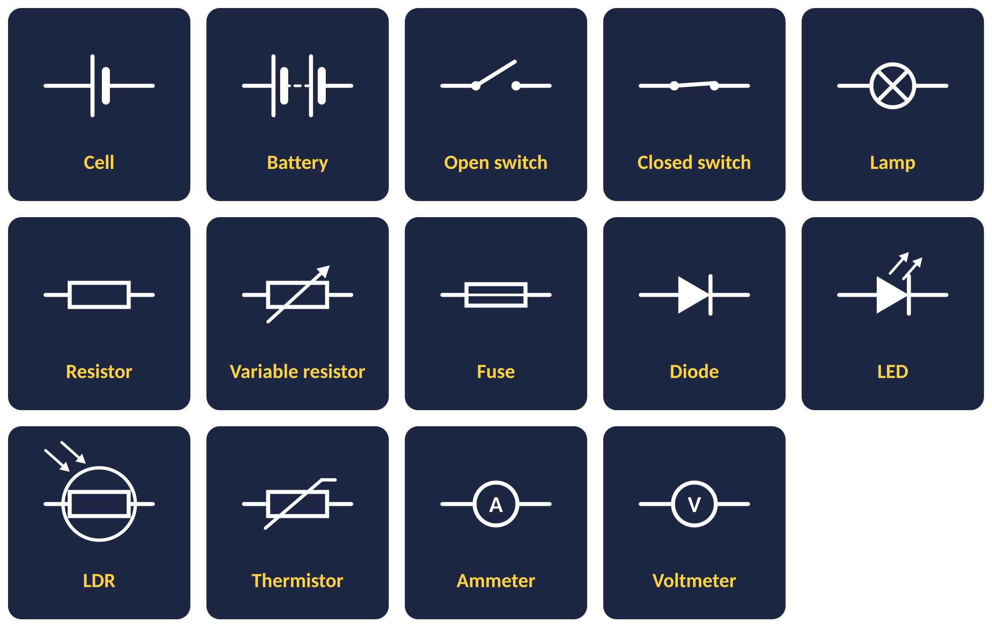
Circuit symbols, LDRs & thermistors
TOPIC 2 · ELECTRICITY
02
‹ INDEX
LDR – light dependent resistor
resistance
Brighter → lower resistance.
Uses: outdoor lights, burglar alarms.
light intensity
Thermistor
resistance
Hotter → lower resistance.
Uses: thermostats, fire alarms.
Ammeters go in series; voltmeters go in parallel across a component.
temperature

Slide 15


Series & parallel circuits
TOPIC 2 · ELECTRICITY
02
‹ INDEX
Series
Parallel
One loop – if one component breaks, everything stops
Separate branches – one can fail, others keep working
Current
I₁ = I₂ = I₃
Current
I_{total} = I₁ + I₂
Same everywhere in the loop
Branch currents add up to the total
P.d.
V_{total} = V₁ + V₂
P.d.
V₁ = V₂
Supply p.d. is shared between components
Every branch gets the full supply p.d.
Resistance
R_{total} = R₁ + R₂
Resistance
R_{total} < smallest R
Adding resistors increases total R
Adding resistors decreases total R

Slide 16
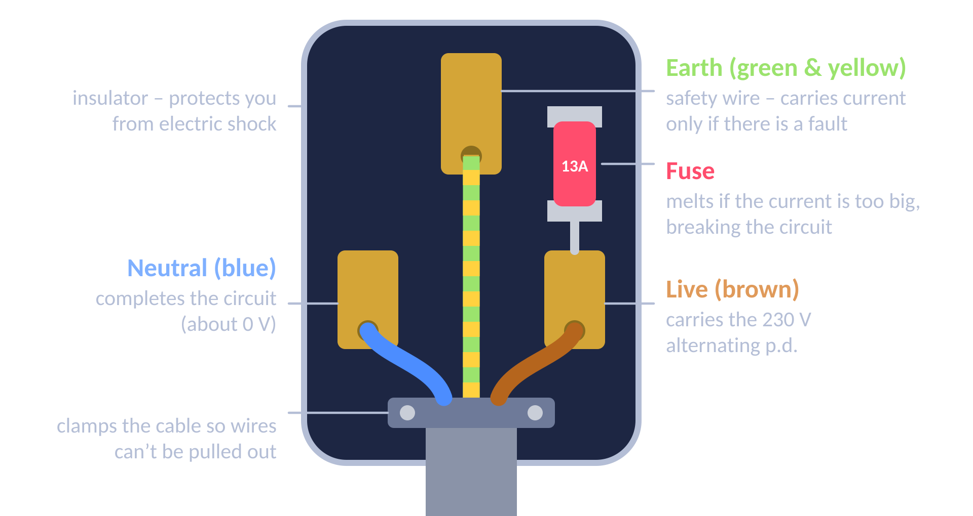
Mains electricity & the National Grid
TOPIC 2 · ELECTRICITY
02
‹ INDEX
230 V
50 Hz
AC vs DC
AC (alternating current): constantly changes direction – the mains supply.
DC (direct current): flows in one direction only – from cells and batteries.
UK mains p.d.
UK mains frequency
The National Grid
Power station
Step-up transformer
Transmission cables
Step-down transformer
Homes
Step-up transformers raise the p.d. to very high values, so the current is low → less energy wasted heating the cables → efficient.
Step-down transformers lower the p.d. to 230 V for use in homes.
Touching the live wire → electric shock, even with the switch off.

Slide 17
Static electricity & electric fields
★ PHYSICS ONLY
TOPIC 2 · ELECTRICITY
02
‹ INDEX
Static charge
Electric field of a + charge
Electric fields
Rubbing two insulators together transfers electrons by friction.
Gains electrons → negatively charged.
Loses electrons → positively charged (with an equal, opposite charge).
Only electrons move – positive charges stay put.
Like charges repel, unlike charges attract – a non-contact force.
e.g. a polythene rod rubbed with a cloth becomes negative.
A charged object creates an electric field around it.
Another charge placed in the field feels a force, which gets stronger closer to the object.
+
Sparks
If the p.d. between a charged object and earth gets big enough, electrons jump the gap – a spark.
A strong field ionises the air so it can conduct. e.g. lightning, shocks from a car door.
Field lines point away from + and towards −, at 90° to the surface.
The field is stronger closer to the charge.

Slide 18
Electricity equations
TOPIC 2 · ELECTRICITY
02
‹ INDEX
CHARGE FLOW
EXAMPLE › 19
OHM’S LAW
EXAMPLE › 19
POWER (V & I)
EXAMPLE › 20
POWER (I & R)
EXAMPLE › 19
Q = I t
V = I R
P = V I
P = I² R
Q in C · I in A · t in s
V in V · I in A · R in Ω
P in W · V in V · I in A
P in W · I in A · R in Ω
ENERGY (POWER)
EXAMPLE › 19
ENERGY (CHARGE)
EXAMPLE › 20
SERIES RESISTANCE
EXAMPLE › 19
UNIT CONVERSION
E = P t
E = Q V
R_{total} = R₁ + R₂
1 kW = 1000 W
E in J · P in W · t in s
E in J · Q in C · V in V
All in Ω
0.5 kW = 500 W · 1 min = 60 s

Slide 19
Electricity worked examples (1)
TOPIC 2 · ELECTRICITY
02
‹ INDEX
WORKED EXAMPLE
WORKED EXAMPLE
WORKED EXAMPLE
A current of 2 A flows for 3 minutes. How much charge flows?
t = 3 × 60 = 180 s
Q = I t = 2 × 180
A 40 Ω resistor carries 0.25 A. Find the p.d. across it.
V = I R
= 0.25 × 40
A 12 V supply drives 3 A through a lamp. Find the resistance.
R = V ÷ I
= 12 ÷ 3
Q = 360 C
V = 10 V
R = 4 Ω
WORKED EXAMPLE
WORKED EXAMPLE
WORKED EXAMPLE
A 2 kW kettle is on for 3 minutes. How much energy is transferred?
P = 2000 W, t = 180 s
E = P t = 2000 × 180
3 A flows through an 8 Ω heater. Calculate the power.
P = I² R
= 3² × 8 = 9 × 8
4 Ω and 6 Ω resistors are in series with a 12 V battery. Find the current.
R_{total} = 4 + 6 = 10 Ω
I = V ÷ R = 12 ÷ 10
E = 360 000 J
P = 72 W
I = 1.2 A

Slide 20
Electricity worked examples (2)
TOPIC 2 · ELECTRICITY
02
‹ INDEX
WORKED EXAMPLE
WORKED EXAMPLE
WORKED EXAMPLE
A 230 V toaster draws a current of 4 A. Find its power.
P = V I
= 230 × 4
A 12 V battery moves 50 C of charge. How much energy is transferred?
E = Q V
= 50 × 12
A 60 W lamp runs from a 12 V supply. Find the current.
I = P ÷ V
= 60 ÷ 12
P = 920 W
E = 600 J
I = 5 A
WORKED EXAMPLE
WORKED EXAMPLE
WORKED EXAMPLE
A 4 Ω resistor dissipates 36 W. Find the current through it.
I² = P ÷ R = 36 ÷ 4 = 9
I = √9
Two parallel branches carry 0.4 A and 0.6 A. Find the total current from the supply.
I_{total} = I₁ + I₂
= 0.4 + 0.6
A 9 V battery powers a lamp and a resistor in series. The lamp has 3.5 V across it. Find the p.d. across the resistor.
V_{total} = V₁ + V₂
V₂ = 9 − 3.5
I = 3 A
I = 1.0 A
V = 5.5 V

Slide 21
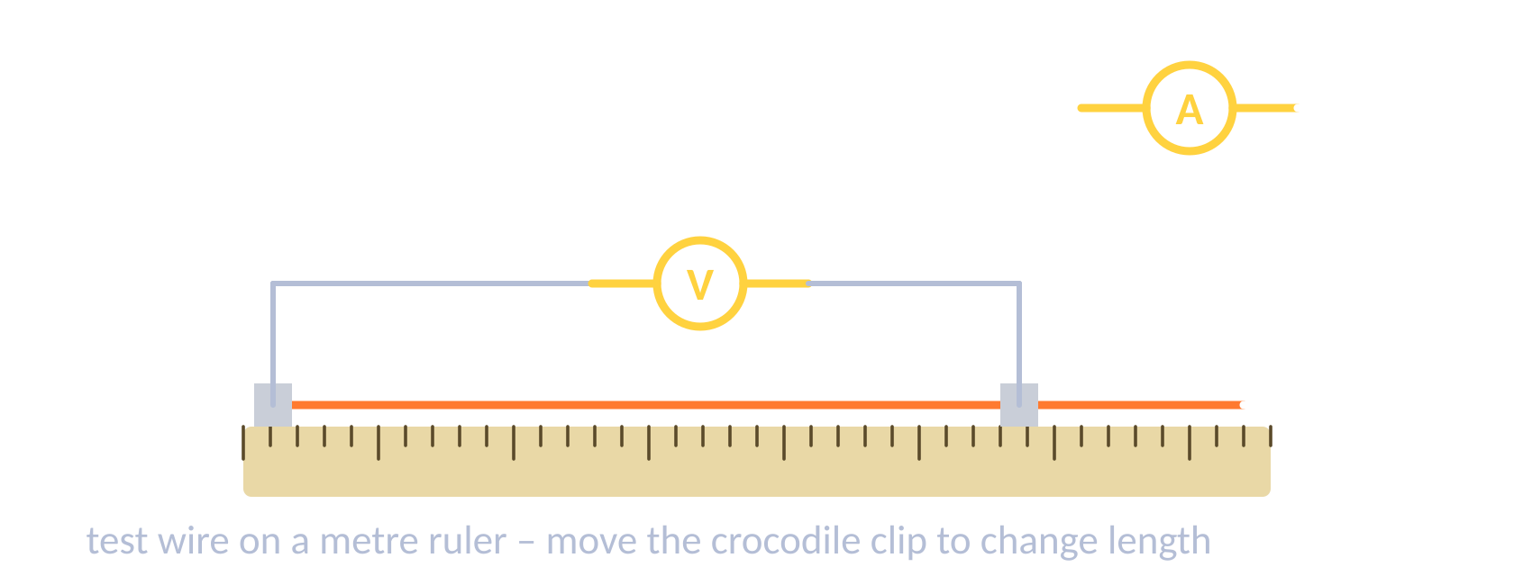

Electricity required practicals
TOPIC 2 · ELECTRICITY
02
‹ INDEX
Resistance of a wire
I–V characteristics
IV: length of wire DV: resistance CV: material, diameter, temperature
1. Clip the wire to a metre ruler; connect with crocodile clips.
2. Ammeter in series, voltmeter across the wire.
3. Measure V and I for different lengths; R = V ÷ I.
Result: resistance is directly proportional to length.
IV: potential difference DV: current CV: component, supply
1. Set up the component with a variable resistor, ammeter in series and voltmeter in parallel.
2. Change the p.d. in steps; record I each time.
3. Reverse the supply connections to get negative values.
4. Plot I (y) against V (x). Repeat for resistor, lamp, diode.

Slide 22
Examiner tips
TOPIC 2 · ELECTRICITY
02
‹ INDEX
1
Meters in the right place
2
Series rules
3
Parallel resistance falls
4
Explain the lamp graph
Ammeter in series, voltmeter in parallel across the component.
Same current everywhere; the supply p.d. is shared between components.
Adding a resistor in parallel decreases total resistance – a favourite “explain” question.
Current ↑ → filament hotter → resistance ↑ → the I–V graph curves.
Watch the prefixes
Safety features
★
★
5
6
7
Only electrons move
8
Field lines
kW → W (× 1000), mA → A (÷ 1000), minutes → s (× 60).
The fuse melts if the current is too big; the earth wire stops the case becoming live.
In static, say electrons were transferred – never “positive charges moved”.
Draw them at 90° to the surface, arrows pointing away from + towards −.

Slide 23

Particle Model of Matter
03
‹ INDEX
IN THIS TOPIC
24 States of matter & density
25 Internal energy & state
26 Latent heat & gas pressure
27 Gas pressure & volume ★
Density, states, latent heat & gas pressure
28 Particle model worked examples
29 Examiner tips

Slide 24
States of matter & density
TOPIC 3 · PARTICLE MODEL OF MATTER
03
‹ INDEX
Solid
Liquid
Gas
Strong forces; fixed, regular pattern. Particles only vibrate. Least energy.
Weaker forces; close together but can move past each other. Irregular.
Almost no forces; far apart, move fast in random directions. Most energy.
ρ = m ÷ V
Density
Density = how much mass is packed into a given volume.
Solids are usually most dense, gases least – gas particles are spread far apart.
A denser material has more particles in the same volume.
density (kg/m³) = mass (kg) ÷ volume (m³)

Slide 25
Internal energy & changes of state
TOPIC 3 · PARTICLE MODEL OF MATTER
03
‹ INDEX
Heating curve for water
Internal energy
gas
Internal energy = total kinetic + potential energy of all the particles in a system.
Heating increases internal energy → either a temperature rise or a change of state.
temperature (°C)
boiling (100 °C)
liquid
Changes of state
melting (0 °C)
Melting S→L Freezing L→S
Boiling/evaporating L→G Condensing G→L
Sublimating S→G
A physical change – it is reversible and mass is conserved. No new substance forms.
solid
time
Flat sections: energy breaks bonds, so temperature stays constant while state changes.

Slide 26
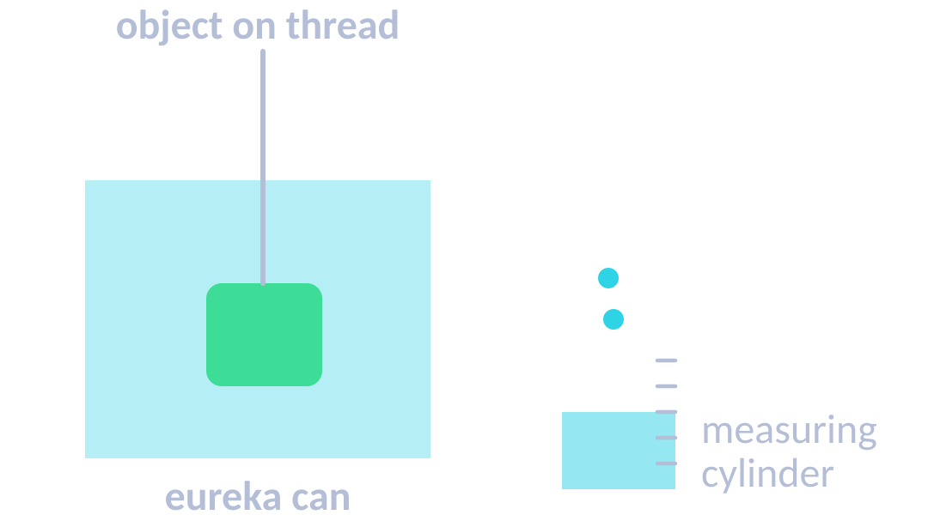
Latent heat, gas pressure & density RP
TOPIC 3 · PARTICLE MODEL OF MATTER
03
‹ INDEX
Specific latent heat
Particle motion in gases
Required practical: density
Energy needed to change the state of 1 kg of a substance without changing its temperature.
Fusion: solid ↔ liquid
Vaporisation: liquid ↔ gas
Energy for a change of state: E = m L
E in J · m in kg · L in J/kg
Condensing / freezing releases energy as bonds form.
Gas particles move in constant random motion, colliding with each other and the container walls.
These collisions produce gas pressure.
At constant volume, higher temperature → faster particles → more frequent, harder collisions → higher pressure.
Temperature is linked to the average kinetic energy of the particles.
Regular: mass on a balance; V = l × w × h.
Irregular: lower into a full eureka can; the water displaced = volume of the object.
Liquid: mass of a known volume.
Then ρ = m ÷ V.

Slide 27

Gas pressure, volume & work done
★ PHYSICS ONLY
TOPIC 3 · PARTICLE MODEL OF MATTER
03
‹ INDEX
FIXED MASS, CONSTANT TEMP.
Changing the volume
WORKED EXAMPLE
p V = constant
Bigger volume → particles hit the walls less often → lower pressure.
Smaller volume → more collisions per second → higher pressure.
Gas at 100 000 Pa fills 0.03 m³. It is squashed to 0.01 m³ at constant temperature. Find the new pressure.
p₁V₁ = p₂V₂
p₂ = 100 000 × 0.03 ÷ 0.01
p in Pa · V in m³
Pressure in a gas
p = 300 000 Pa
Work done on a gas (HT)
WORKED EXAMPLE
Doing work on a gas (e.g. pumping up a bike tyre) transfers energy to it.
Its internal energy increases, so its temperature rises.
A 1.0 m³ balloon at 100 kPa rises to where the pressure is 80 kPa. Temperature is constant. Find its new volume.
V₂ = p₁V₁ ÷ p₂
= 100 × 1.0 ÷ 80
Particles hit the walls → force at 90° → pressure.
Hotter → faster → more frequent collisions → higher pressure.
V = 1.25 m³

Slide 28
Particle model worked examples
TOPIC 3 · PARTICLE MODEL OF MATTER
03
‹ INDEX
DENSITY
SPECIFIC LATENT HEAT
SPECIFIC HEAT CAPACITY
ρ = m ÷ V
E = m L
ΔE = m c Δθ
kg/m³ · kg · m³
J · kg · J/kg
J · kg · J/kg °C · °C
WORKED EXAMPLE
WORKED EXAMPLE
WORKED EXAMPLE
An object has density 8050 kg/m³ and volume 3.4 m³. Find its mass.
m = ρ × V
= 8050 × 3.4
A 50 g block measures 2 cm × 2 cm × 5 cm. Find its density in kg/m³.
m = 0.05 kg
V = 20 cm³ = 0.00002 m³
ρ = 0.05 ÷ 0.00002
0.2 kg of ice melts at 0 °C. L(fusion) = 334 000 J/kg. Find the energy needed.
E = m L
= 0.2 × 334 000
m = 27 370 kg ≈ 27 000 kg
ρ = 2500 kg/m³
E = 66 800 J

Slide 29
Examiner tips
TOPIC 3 · PARTICLE MODEL OF MATTER
03
‹ INDEX
1
Density units
2
Flat = changing state
3
SHC vs SLH
4
Internal energy
kg/m³: convert cm³ → m³ (÷ 1 000 000), or work in g/cm³ throughout.
Temperature stays constant during a change of state – energy breaks bonds instead.
Specific heat capacity → temperature change. Specific latent heat → change of state.
Always mention both kinetic and potential energy of the particles.
Gas pressure chain
Mass is conserved
★
★
5
6
7
pV = constant
8
Work done on a gas
Particles hit the walls → force → pressure. Hotter → faster → more frequent, harder collisions.
Changes of state are physical and reversible – no new substance forms.
Only works for a fixed mass of gas at constant temperature – say so.
Doing work (e.g. a bike pump) raises its internal energy and temperature.

Slide 30

Atomic Structure
04
‹ INDEX
IN THIS TOPIC
31 Atoms & the model of the atom
32 Isotopes & nuclear radiation
33 Nuclear decay equations
34 Half-life & contamination
Radiation, half-life, fission & fusion
35 Background & uses ★
36 Fission & fusion ★
37 Examiner tips

Slide 31



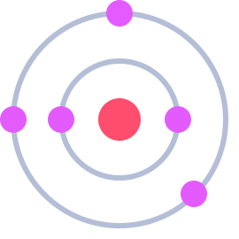

Atoms & the model of the atom
TOPIC 4 · ATOMIC STRUCTURE
04
‹ INDEX
Particle | Relative charge | Relative mass | Where
Proton | +1 | 1 | Nucleus
Neutron | 0 | 1 | Nucleus
Electron | −1 | Very small | Shells around nucleus
Key facts
Atom radius ≈ 1 × 10⁻¹⁰ m; nucleus < 1/10 000 of that.
Atoms are neutral: protons = electrons.
Atomic number = protons. Mass number = protons + neutrons.
Electrons move to higher shells by absorbing EM radiation.
Development of the model of the atom
Early 1800s
1897
1909–11
1913
1932
Dalton
Thomson
Rutherford
Bohr
Chadwick
Atoms are tiny solid spheres that cannot be divided.
Discovers the electron → plum pudding: positive ball with electrons in it.
Alpha scattering: mass & charge in a tiny nucleus; mostly empty space.
Electrons orbit in fixed shells (energy levels).
Discovers the neutron in the nucleus.

Slide 32
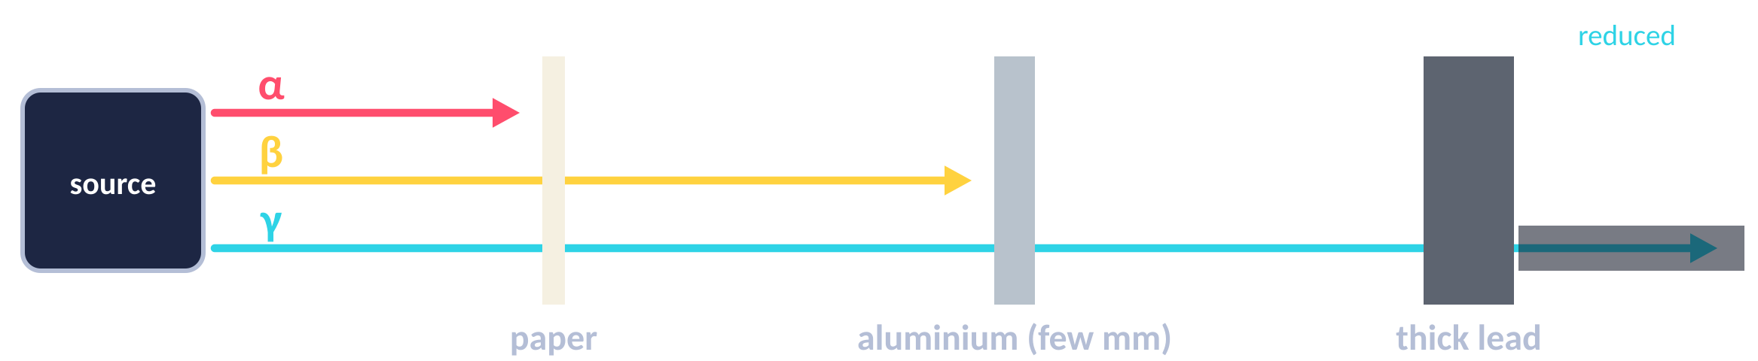
Isotopes & nuclear radiation
TOPIC 4 · ATOMIC STRUCTURE
04
‹ INDEX
 | Alpha α | Beta β | Gamma γ
What is it? | Helium nucleus (2p + 2n) | Fast electron from the nucleus | EM wave
Symbol | ⁴₂He or α | ⁰₋₁e or β | γ
Ionising power | Very high | Medium | Low
Range in air | A few cm | About 1 m | Very far
Stopped by | Paper or skin | A few mm of aluminium | Thick lead / concrete
Most dangerous | Inside the body | Outside the body | Outside the body
Isotopes
Atoms of the same element with the same number of protons but a different number of neutrons.
Same atomic number, different mass number.
Some isotopes are unstable – their nuclei decay randomly, giving out radiation.
Activity = rate of decay, in becquerels (Bq). 1 Bq = 1 decay per second.
Count rate = decays recorded per second by a Geiger–Müller tube.
¹₁H
²₁H
³₁H
hydrogen
deuterium
tritium

Slide 33
Nuclear decay equations
TOPIC 4 · ATOMIC STRUCTURE
04
‹ INDEX
Alpha decay
Beta decay
Gamma emission
²³⁸₉₂U → ²³⁴₉₀Th + ⁴₂He
¹⁴₆C → ¹⁴₇N + ⁰₋₁e
^{99m}₄₃Tc → ⁹⁹₄₃Tc + γ
Nucleus loses 2 protons + 2 neutrons.
Mass number −4, atomic number −2.
A neutron turns into a proton + electron; the electron is emitted.
Mass number same, atomic number +1.
Nucleus gets rid of excess energy as an EM wave.
No change to mass or atomic number.
WORKED EXAMPLE
WORKED EXAMPLE
Radium-226 (atomic number 88) emits an alpha particle. What is formed?
Mass: 226 − 4 = 222 Atomic: 88 − 2 = 86
Iodine-131 (atomic number 53) emits a beta particle. What is formed?
Mass: stays 131 Atomic: 53 + 1 = 54
Radon-222 (²²²₈₆Rn)
Xenon-131 (¹³¹₅₄Xe)

Slide 34
Half-life, contamination & irradiation
TOPIC 4 · ATOMIC STRUCTURE
04
‹ INDEX
Half-life
Time for the number of unstable nuclei (or the activity) to halve.
Decay is random – we can’t predict which nucleus decays next.
Contamination
Radioactive atoms get onto or into an object. Keeps irradiating until removed.
Protection: gloves, protective clothing, tongs.
WORKED EXAMPLE
A sample has activity 800 Bq and half-life 2 days. Find its activity after 6 days.
6 ÷ 2 = 3 half-lives: 800 → 400 → 200 → 100
HT: net decline = 700 Bq, ratio 700 : 800 = 7/8
Irradiation
Exposure to radiation from an outside source. The object does not become radioactive.
Protection: lead shielding, distance, limit time.
Activity = 100 Bq

Slide 35
Background radiation & uses of radiation
★ PHYSICS ONLY
TOPIC 4 · ATOMIC STRUCTURE
04
‹ INDEX
1 Sv
≈ 2.7 mSv
Choosing a half-life
Uses in medicine
Every isotope has its own half-life – from fractions of a second to billions of years.
Medical tracers need a short half-life so they don’t stay active in the body for long.
Long half-life sources stay hazardous for a long time – nuclear waste must be stored safely for thousands of years.
Hazard depends on the half-life and the type of radiation.
Tracers: a gamma emitter is swallowed or injected and detected outside the body to spot problems.
Radiotherapy: gamma beams or implants kill cancer cells – but can also damage healthy cells.
Sterilising equipment with gamma.
Doctors weigh the risk against the benefit.
= 1000 mSv
typical UK yearly dose
Background radiation
Radiation around us all the time.
Natural: rocks (radon gas), cosmic rays from space, food & drink.
Man-made: fallout from weapons testing, nuclear accidents, medical X-rays.
Your dose (in sieverts) depends on your job and where you live.

Slide 36
Nuclear fission & fusion
★ PHYSICS ONLY
TOPIC 4 · ATOMIC STRUCTURE
04
‹ INDEX
Fission chain reaction
Fusion
+ energy (and gamma rays)
Two light nuclei join to make a heavier nucleus (e.g. hydrogen → helium).
Some mass is converted to energy – it releases more energy per kg of fuel than fission.
Happens in stars. Needs extremely high temperature & pressure, so it isn’t yet used in power stations.
more fissions…
neutron
U-235
2–3 neutrons
two smaller nuclei
Fission = splitting
Fusion = joining
Fission
A large unstable nucleus (e.g. uranium-235) absorbs a neutron and splits into two smaller nuclei, releasing 2–3 neutrons and energy.
Control rods absorb neutrons to control the chain reaction. Uncontrolled → explosion (nuclear weapon).

Slide 37
Examiner tips
TOPIC 4 · ATOMIC STRUCTURE
04
‹ INDEX
1
Balance both numbers
2
Know the particles
3
Half-life from a graph
4
Contamination ≠ irradiation
In decay equations the top (mass) numbers and bottom (atomic) numbers must both balance.
Alpha = ⁴₂He, beta = ⁰₋₁e. Gamma changes neither number.
Pick any activity, find when it has halved, and read the time difference.
Contamination: the source gets on/in you. Irradiation: exposed from outside – you don’t become radioactive.
Evidence changes models
Ionising vs penetrating
★
★
5
6
7
Fission order
8
Choosing an isotope
Alpha scattering showed a tiny, dense, positive nucleus – this replaced plum pudding.
Alpha: most ionising, least penetrating. Gamma: the reverse.
The nucleus absorbs a neutron first, then splits, releasing 2–3 neutrons → chain reaction.
Medical tracers: gamma emitter with a short half-life. Justify with both.

Slide 38

Forces
05
‹ INDEX
IN THIS TOPIC
39 Scalars, vectors & types of force
40 Resultant forces & work done
41 Forces & elasticity
42 Speed, velocity & motion graphs
43 Acceleration & Newton’s laws
44 Stopping distances & momentum
Motion, Newton, momentum, moments & pressure
45 Moments, levers & gears ★
46 Pressure in fluids ★
47 Momentum & safety ★
48 Forces equations
49 Forces worked examples (1)
50 Forces worked examples (2)
51 Examiner tips

Slide 39
Scalars, vectors & types of force
TOPIC 5 · FORCES
05
‹ INDEX
Scalar – magnitude only
Vector – magnitude + direction
Vectors are drawn as arrows: length = size, direction = direction.
Speed is the scalar size of velocity.
distance
speed
mass
displacement
velocity
force
time
energy
temperature
acceleration
weight
momentum
Contact vs non-contact
Weight
Resultant force
Contact (touching): friction, air resistance, tension, normal contact force.
Non-contact (at a distance): gravitational, electrostatic, magnetic.
W = m g (N = kg × N/kg)
Weight is the force of gravity on a mass. On Earth g ≈ 9.8 N/kg.
Acts at the centre of mass. Measured with a newtonmeter. W ∝ m.
30 N
50 N
50 − 30 = 20 N to the right → it accelerates right.
Resultant 0 N = balanced forces (equilibrium).

Slide 40
Resultant forces & work done
TOPIC 5 · FORCES
05
‹ INDEX
Forces at right angles
Work done
When a force moves an object, work is done and energy is transferred.
W = F s (J = N × m)
1 joule = work done when 1 N moves an object 1 m (1 J = 1 N m).
Work done against friction raises the temperature of the object.
Draw tip-to-tail to scale, or use Pythagoras:
R = √(100² + 100²) = 141 N
HT: a single force can be resolved into two components at right angles.
resultant
100 N
WORKED EXAMPLE
A man pushes his broken-down car with a force of 160 N for 15 m. How much work does he do?
W = F s
= 160 × 15
100 N
If forces aren’t at 90°, use a scale drawing (parallelogram of forces) and measure the diagonal.
W = 2400 J

Slide 41
Forces & elasticity
TOPIC 5 · FORCES
05
‹ INDEX
Force–extension graph
Elastic vs inelastic deformation
force (N)
More than one force is needed to stretch, squash or bend an object.
Elastic: returns to its original shape when the force is removed.
Inelastic: permanently deformed – does not return.
limit of proportionality
Required practical: force & extension
extension (m)
1. Hang a spring from a clamp next to a vertical ruler; record its original length.
2. Add masses one at a time; record the new length each time.
3. Extension = new length − original length. Weight = m × 9.8.
4. Plot force (y) against extension (x). Gradient = k.
Work done stretching = elastic PE stored: E_{e} = ½ k e².
Hooke’s law: F = k e
Extension ∝ force up to the limit of proportionality. Gradient = spring constant k (N/m).

Slide 42
Speed, velocity & motion graphs
TOPIC 5 · FORCES
05
‹ INDEX
1.5
3
6
13–30
250
330
walking (m/s)
running (m/s)
cycling (m/s)
car (m/s)
aircraft (m/s)
sound in air (m/s)
Key ideas
Distance–time
Velocity–time
Distance (scalar) – how far. Displacement (vector) – straight line from start to end, with direction.
Speed: s = v t, so v = s ÷ t (s = distance).
Velocity: speed in a given direction. Moving in a circle at constant speed means velocity is changing.
distance
velocity
time
time
Gradient = speed
Flat line = stationary
Curve = changing speed (HT: tangent)
Gradient = acceleration
Flat line = constant velocity
HT: area under = distance

Slide 43
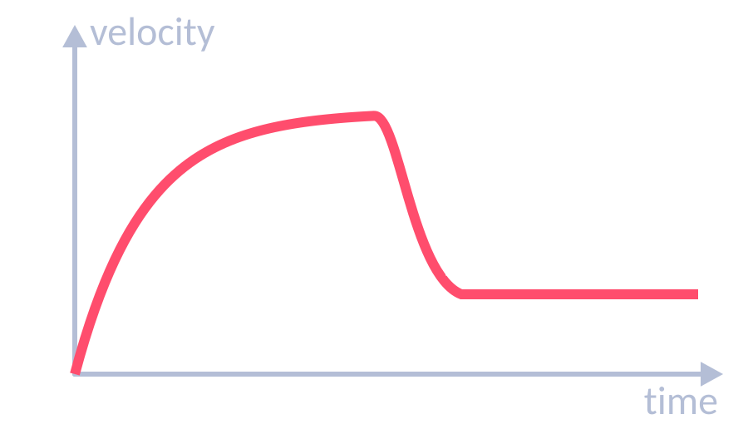
Acceleration & Newton’s laws
TOPIC 5 · FORCES
05
‹ INDEX
1st law
2nd law
3rd law
If the resultant force is zero, a stationary object stays still and a moving object keeps the same speed and direction.
Acceleration ∝ resultant force and inversely ∝ mass: F = m a. Inertial mass = F ÷ a.
When two objects interact, they exert equal and opposite forces on each other (same type of force).
Acceleration
Terminal velocity
Required practical: F = ma
a = Δv ÷ t (m/s²)
v² − u² = 2 a s
Free fall: a ≈ 9.8 m/s².
Deceleration = negative acceleration.
Weight > drag → accelerates.
Drag rises with speed until drag = weight → terminal velocity.
Parachute → more drag → lower terminal velocity.
Trolley pulled by hanging masses; light gates measure acceleration.
Vary force (keep total mass constant) or vary mass.
Result: a ∝ F; a ∝ 1/m.

Slide 44
Stopping distances & momentum
TOPIC 5 · FORCES
05
‹ INDEX
Braking
Friction between brakes and wheel does work, transferring kinetic energy to thermal energy in the brakes.
Higher speed → bigger braking force needed → large deceleration can overheat brakes.
Reaction time: measure with the ruler-drop test.
Momentum (HT)
p = m v (kg m/s = kg × m/s)
Conservation of momentum: in a closed system, total momentum before = total momentum after an event (collision or explosion).
Stopping distance = thinking + braking
Thinking ↑ with speed, tiredness, drugs, alcohol, distractions (reaction time 0.2–0.9 s).
Braking ↑ with speed, wet/icy roads, worn brakes or tyres.

Slide 45
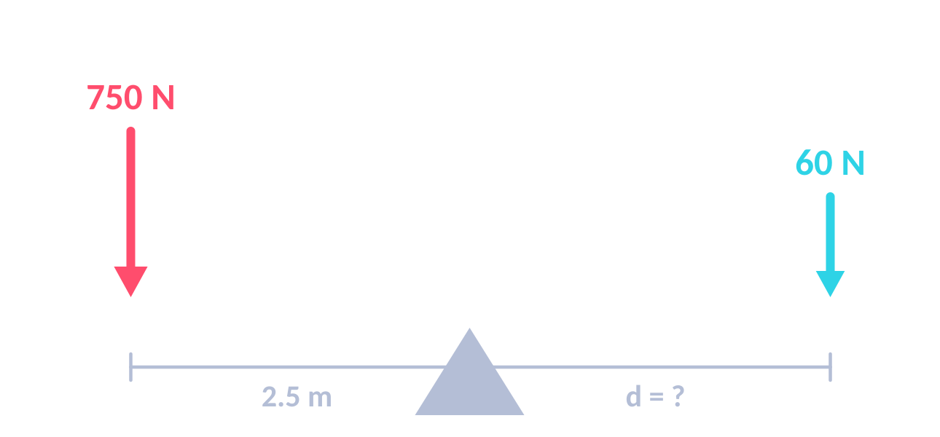
Moments, levers & gears
★ PHYSICS ONLY
TOPIC 5 · FORCES
05
‹ INDEX
MOMENT
Levers & gears
M = F d
Levers are force multipliers: a longer distance from the pivot gives a bigger moment.
Gears transmit rotation. A bigger gear gives a bigger moment but turns more slowly; meshed gears turn opposite ways.
M in N m · F in N · d = perpendicular distance from pivot (m)
WORKED EXAMPLE
WORKED EXAMPLE
WORKED EXAMPLE
A 10 N force is applied 0.5 m from the pivot of a crowbar. Find the moment.
M = F d = 10 × 0.5
A 750 N elephant sits 2.5 m from a seesaw pivot. A 60 N mouse balances it. How far is the mouse from the pivot?
750 × 2.5 = 60 × d
d = 1875 ÷ 60
A gear of radius 0.25 m has a moment of 30 N m. It turns a gear of radius 1.5 m. Find the larger gear’s moment.
F = M ÷ d = 30 ÷ 0.25 = 120 N
M = 120 × 1.5
M = 5 N m
d = 31.25 m ≈ 31 m
M = 180 N m

Slide 46
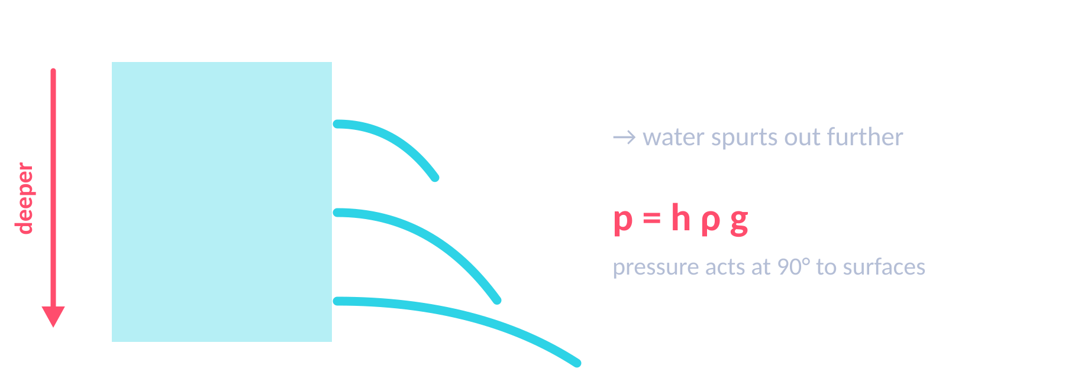
Pressure in fluids & upthrust
★ PHYSICS ONLY
TOPIC 5 · FORCES
05
‹ INDEX
PRESSURE
LIQUID COLUMN (HT)
p = F ÷ A
p = h ρ g
p in Pa (N/m²) · F in N · A in m²
Pa · h in m · ρ in kg/m³ · g in N/kg
Upthrust (HT)
WORKED EXAMPLE
WORKED EXAMPLE
Pressure on the bottom of a submerged object is greater than on the top → resultant upward force: upthrust.
Floats if upthrust = weight (less dense than the fluid).
Atmospheric pressure falls with height – less air above.
An elephant exerts 4500 N on a frozen pond over 30 m². Find the pressure.
p = F ÷ A
= 4500 ÷ 30
HT: Find the pressure from 10 m of sea water (ρ = 1030 kg/m³, g = 9.8 N/kg).
p = h ρ g
= 10 × 1030 × 9.8 = 100 940 Pa
p = 150 Pa
p ≈ 1.0 × 10⁵ Pa

Slide 47
Momentum, force & car safety
★ PHYSICS ONLY
TOPIC 5 · FORCES
05
‹ INDEX
FORCE & MOMENTUM (HT)
Safety features increase the stopping time
F = m Δv ÷ Δt
Taking longer to stop → momentum changes more slowly → smaller force on the passenger.
Seat belts stretch • Air bags deflate slowly • Crumple zones squash
Cycle helmets & crash mats compress on impact
force = rate of change of momentum
WORKED EXAMPLE
WORKED EXAMPLE
WORKED EXAMPLE
HT: A 12 000 kg lorry at 20 m/s hits a stationary 1500 kg car. They move off together. Find their velocity.
p before = 12 000 × 20 = 240 000 kg m/s
v = 240 000 ÷ 13 500
HT: A cannon fires a 5 kg ball at 90 m/s and recoils at 2 m/s. Find the cannon’s mass.
Total p before = 0
ball: 5 × 90 = 450 kg m/s
m = 450 ÷ 2
HT: A 70 kg passenger stops from 15 m/s in 0.1 s. Find the force. (With an air bag it takes 0.5 s.)
F = 70 × 15 ÷ 0.1 = 10 500 N
With air bag: 1050 ÷ 0.5 = 2100 N
v = 17.8 m/s
m = 225 kg
F = 10 500 N → 2100 N

Slide 48
Forces equations
TOPIC 5 · FORCES
05
‹ INDEX
WEIGHT
EX › 49
RESULTANT FORCE
EX › 49
WORK DONE
EX › 40
HOOKE’S LAW
EX › 49
SPEED
EX › 49
W = m g
F = m a
W = F s
F = k e
s = v t
N · kg · N/kg
N · kg · m/s²
J · N · m
N · N/m · m
s (distance) in m · m/s · s
ACCELERATION
EX › 50
UNIFORM ACCELERATION
EX › 50
ELASTIC PE
EX › 49
MOMENTUM (HT)
EX › 50
CONVERT FIRST!
a = Δv ÷ t
v² − u² = 2 a s
E_{e} = ½ k e²
p = m v
km→m ×1000
m/s² · m/s · s
m/s · m/s² · m
J · N/m · m
kg m/s · kg · m/s
min→s ×60 · g→kg ÷1000 · cm→m ÷100

Slide 49
Forces worked examples (1)
TOPIC 5 · FORCES
05
‹ INDEX
WORKED EXAMPLE
WORKED EXAMPLE
WORKED EXAMPLE
Find the weight of a 60 kg student on Earth (g = 9.8 N/kg).
W = m g
= 60 × 9.8
A 1200 kg car accelerates at 2.5 m/s². Find the resultant force.
F = m a
= 1200 × 2.5
A spring stretches 0.04 m under a 2 N force. Find k.
k = F ÷ e
= 2 ÷ 0.04
W = 588 N
F = 3000 N
k = 50 N/m
WORKED EXAMPLE
WORKED EXAMPLE
WORKED EXAMPLE
A bungee cord holding an 800 N jumper stretches 25 m. Find the elastic PE stored.
k = F ÷ e = 800 ÷ 25 = 32 N/m
E_{e} = ½ × 32 × 25²
John runs 5 km in 25 minutes. Find his average speed in m/s.
s = 5000 m, t = 25 × 60 = 1500 s
v = s ÷ t = 5000 ÷ 1500
A car travels 15 miles at an average 65 mph. How long does it take, in minutes?
t = s ÷ v = 15 ÷ 65 = 0.23 h
0.23 × 60
E_{e} = 10 000 J
v = 3.3 m/s
t ≈ 14 minutes

Slide 50
Forces worked examples (2)
TOPIC 5 · FORCES
05
‹ INDEX
WORKED EXAMPLE
WORKED EXAMPLE
WORKED EXAMPLE
A dog reaches 4 m/s from rest in 16 s. Find its acceleration.
a = Δv ÷ t
= (4 − 0) ÷ 16
A bus at 2 m/s accelerates at 1.5 m/s² over 50 m. Find its final velocity.
v² = u² + 2 a s
= 2² + (2 × 1.5 × 50) = 154
v = √154
A driver at 20 m/s has a reaction time of 0.7 s. Braking distance is 30 m. Find the stopping distance.
thinking = 20 × 0.7 = 14 m
stopping = 14 + 30
a = 0.25 m/s²
v = 12.4 m/s
Stopping = 44 m
WORKED EXAMPLE
WORKED EXAMPLE
WORKED EXAMPLE
HT: An 85 kg cyclist travels at 12 m/s. Find their momentum.
p = m v
= 85 × 12
HT: A 2 kg trolley at 3 m/s hits a stationary 1 kg trolley; they stick together. Find their velocity.
p before = 2 × 3 = 6 kg m/s
v = 6 ÷ (2 + 1)
A crate is pushed with 50 N right; friction is 35 N left. Find the resultant force.
Forces in a line: subtract
50 − 35 = 15
p = 1020 kg m/s
v = 2 m/s
F = 15 N to the right

Slide 51
Examiner tips
TOPIC 5 · FORCES
05
‹ INDEX
1
Free-body diagrams
2
Mass ≠ weight
3
Read the graph
4
v² − u² = 2as
Draw arrows from the object, to scale, and label each force.
Mass in kg; weight is a force in N. W = m g.
Gradient of d–t = speed; gradient of v–t = acceleration; HT: area under v–t = distance.
Square the speeds, rearrange, then take the square root at the end.
Stopping distance
Momentum has direction
★
★
5
6
7
Perpendicular distance
8
Area units
Thinking distance → driver factors. Braking distance → car & road factors. Don’t mix them.
Give opposite velocities opposite signs (+/−) before adding momenta.
Moments use the perpendicular distance from the pivot to the line of the force.
Convert cm² → m² by ÷ 10 000 before using p = F ÷ A.

Slide 52

Waves
06
‹ INDEX
IN THIS TOPIC
53 Wave types & properties
54 Measuring waves
55 The electromagnetic spectrum
56 Refraction & infrared radiation
EM spectrum, sound, lenses & black bodies
57 Sound & seismic waves ★
58 Lenses & visible light ★
59 Black body & light RP ★
60 Equations & worked examples
61 Examiner tips

Slide 53
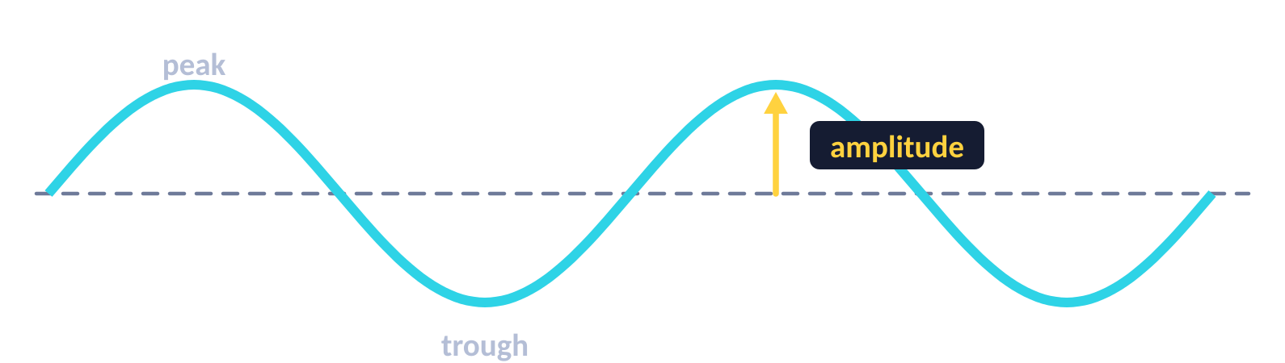
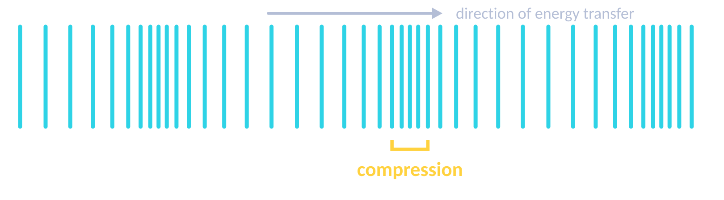
Transverse & longitudinal waves
TOPIC 6 · WAVES
06
‹ INDEX
Transverse
Longitudinal
Vibrations are parallel to the direction of energy transfer, e.g. sound waves.
Compression: particles squashed close together (higher pressure).
Rarefaction: particles spread further apart (lower pressure).
Vibrations are perpendicular to the direction of energy transfer. E.g. water ripples, all EM waves.
Amplitude
Wavelength λ
Frequency f
Period T
Wave speed v
Max displacement from rest position to a peak or trough (m)
Distance from one point to the same point on the next wave (m)
Number of waves passing a point each second (Hz)
Time for one wave to pass: T = 1 ÷ f (s)
Speed energy is transferred: v = f λ (m/s)

Slide 54
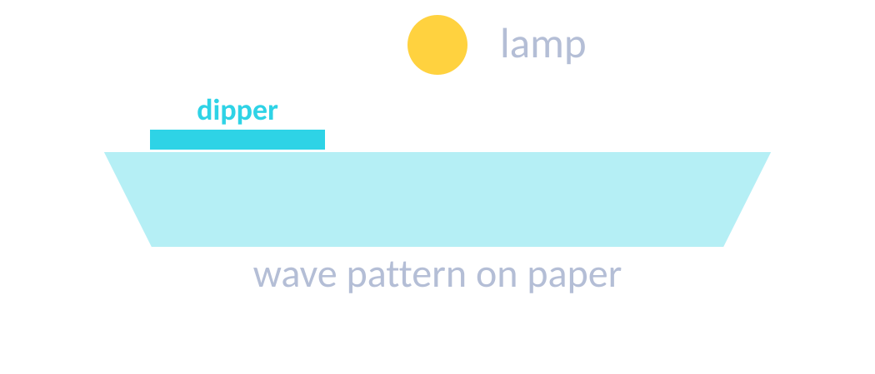
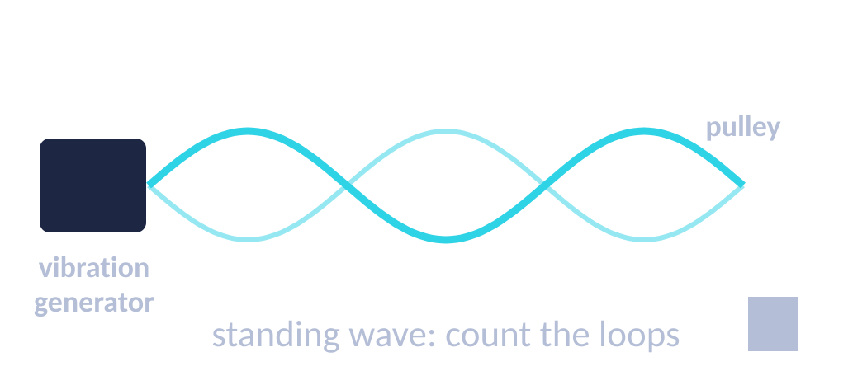
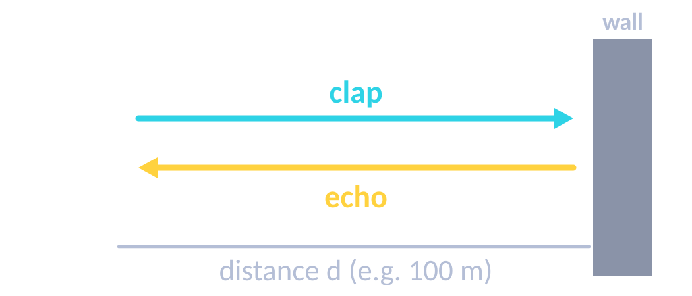
Measuring waves
TOPIC 6 · WAVES
06
‹ INDEX
Ripple tank (RP)
Waves on a string (RP)
Speed of sound (echo)
1. Adjust the signal generator until waves are clear (low frequency is easier).
2. λ: measure across 10 waves and ÷ 10 (a strobe can freeze the pattern).
3. f: count waves passing a point in 10 s and ÷ 10.
4. v = f λ
1. Adjust the frequency until a clear standing wave appears.
2. λ: measure several loops – each loop is ½ λ.
3. f = the signal generator setting.
4. v = f λ
1. Stand a measured distance from a large wall (e.g. 100 m).
2. Clap and time how long until you hear the echo.
3. Sound goes there and back: distance = 2d.
4. speed = 2d ÷ time. Repeat and average.

Slide 55
The electromagnetic spectrum
TOPIC 6 · WAVES
06
‹ INDEX
Radio
Microwave
Infrared
Visible
Ultraviolet
X-ray
Gamma
USES
USES
USES
USES
USES
USES
USES
TV & radio
Satellites, cooking
Heaters, thermal cameras, remotes
Fibre optics, seeing
Tanning, energy-efficient lamps, security marks
Medical imaging, airport security
Sterilising, cancer treatment
HAZARD
HAZARD
HAZARD
HAZARD
HAZARD
HAZARD
HAZARD
Low risk
Internal heating
Skin burns
Bright light can damage eyes
Skin cancer, ageing
Mutations → cancer
Mutations → cancer
increasing frequency & energy · decreasing wavelength →
Remember:
Roman Men Invented Very Unusual X-ray Guns
All EM waves
Transverse; travel at the same speed in a vacuum; transfer energy from source to absorber.

Slide 56
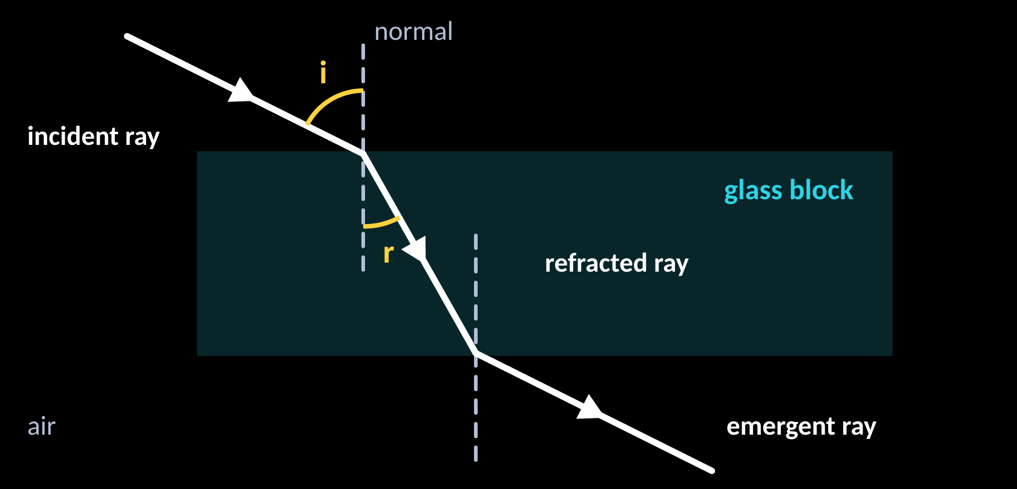
Refraction & infrared radiation
TOPIC 6 · WAVES
06
‹ INDEX
Refraction through a glass block
Absorbing & emitting infrared
All objects emit and absorb infrared. Hotter objects emit more.
Dark, matt surfaces are the best absorbers and emitters.
Light, shiny surfaces are the worst – they reflect infrared.
Required practical: Leslie cube
Into a denser medium: wave slows down and bends towards the normal.
Out of it: speeds up and bends away from the normal.
Along the normal (90° to surface): speed changes, no change of direction.
HT: wavelength changes, frequency stays the same.
1. Fill a Leslie cube with hot water from a kettle; replace the lid.
2. Use an infrared detector at the same distance from each face.
3. Record the reading for each surface (black matt, white, shiny…).
Result: black matt emits the most infrared radiation.

Slide 57
Sound, ultrasound & seismic waves
★ PHYSICS ONLY
TOPIC 6 · WAVES
06
‹ INDEX
20 Hz – 20 kHz
330 m/s
1500 m/s
> 20 kHz
human hearing range
sound in air
sound in water
ultrasound
Sound waves
Ultrasound (HT)
Seismic waves (HT)
Longitudinal; travel fastest in solids and can’t cross a vacuum.
Eardrum vibrates → small bones → cochlea. Frequency stays the same across a boundary; speed and wavelength change.
Partly reflected at boundaries between materials. The echo time gives the distance.
Uses: pre-natal scans, finding cracks in metal, sonar / echo sounding.
P-waves: longitudinal, travel through solids & liquids.
S-waves: transverse, solids only.
The S-wave shadow zone is evidence of Earth’s liquid outer core.
WORKED EXAMPLE
A sonar pulse returns 0.4 s after it is sent. Sound travels at 1500 m/s in water. How deep is the sea bed?
depth = v × t ÷ 2 = 1500 × 0.4 ÷ 2 (there and back)
depth = 300 m

Slide 58
Lenses & visible light
★ PHYSICS ONLY
TOPIC 6 · WAVES
06
‹ INDEX
Convex (converging) lens
MAGNIFICATION
Parallel rays meet at the principal focus F.
Image can be real or virtual (magnifying glass).
magnification = image height ÷ object height
no units
F
Visible light & colour
Each colour (ROYGBIV) is a narrow band of wavelengths. Specular reflection: smooth surface, one direction. Diffuse: rough surface, scattered.
Opaque objects look the colour they reflect; filters only transmit certain colours.
Concave (diverging) lens
Rays spread out as if from F.
Image is always virtual, upright and smaller.
WORKED EXAMPLE
F
A 2 cm object gives an 8 cm image. Find the magnification.
8 ÷ 2
magnification = 4

Slide 59
Black body radiation & light practical
★ PHYSICS ONLY
TOPIC 6 · WAVES
06
‹ INDEX
Emission spectrum vs temperature
Temperature of the Earth (HT)
intensity
— hotter
Light from the Sun is absorbed and the surface warms; the Earth emits infrared.
Some IR is absorbed and re-emitted by greenhouse gases. Earth’s temperature depends on the balance between absorbing and emitting radiation.
— cooler
wavelength
Required practical: reflection & refraction
1. Put a glass block on paper; draw round it and draw a normal.
2. Shine a ray box ray at an angle; mark the incident, reflected and emergent rays.
3. Measure angles of incidence, reflection and refraction with a protractor.
4. Repeat with an acrylic block. Safety: the ray box gets hot.
Black body radiation
A perfect black body absorbs all radiation that hits it – it is also the best emitter.
Hotter objects emit more radiation and at shorter wavelengths. At constant temperature: absorbed = emitted.

Slide 60
Waves equations & worked examples
TOPIC 6 · WAVES
06
‹ INDEX
WAVE SPEED
PERIOD
SPEED (ECHO)
v = f λ
T = 1 ÷ f
s = v t
m/s · Hz · m
s · Hz
remember: s = 2 × distance to wall
WORKED EXAMPLE
WORKED EXAMPLE
Ripples have frequency 5 Hz and wavelength 0.02 m. Find their speed.
v = f λ = 5 × 0.02
A radio wave (v = 3 × 10⁸ m/s) has f = 100 MHz. Find λ.
λ = v ÷ f = 300 000 000 ÷ 100 000 000
v = 0.1 m/s
λ = 3 m
WORKED EXAMPLE
WORKED EXAMPLE
A clap echoes off a wall 100 m away after 0.6 s. Find the speed of sound.
s = 2 × 100 = 200 m; v = s ÷ t = 200 ÷ 0.6
A wave has frequency 0.25 Hz. Find its period.
T = 1 ÷ f = 1 ÷ 0.25
v = 333 m/s
T = 4 s

Slide 61
Examiner tips
TOPIC 6 · WAVES
06
‹ INDEX
1
Measure many waves
2
Echo = double distance
3
Refraction
4
EM spectrum order
Measure across several waves and divide – this reduces uncertainty.
The sound goes there and back – double the distance to the wall.
Speed and wavelength change; frequency doesn’t. Slower → bends towards the normal.
Radio → gamma (“Roman Men Invented…”). Learn one use and one hazard for each.
Standard form
Describe the wave type
★
★
5
6
7
Ray diagrams
8
Black bodies
3 × 10⁸ m/s; MHz = × 10⁶; kHz = × 10³.
Say how the oscillations move relative to the direction of energy transfer.
Use a ruler. A ray through the centre of a lens goes straight on.
Hotter → more radiation emitted and a shorter peak wavelength.

Slide 62

Magnetism & Electromagnetism
07
‹ INDEX
IN THIS TOPIC
63 Magnets & magnetic fields
64 Electromagnetism
65 The motor effect
66 Generator effect ★
Motor effect, induction & transformers
67 Transformers ★
68 Examiner tips

Slide 63
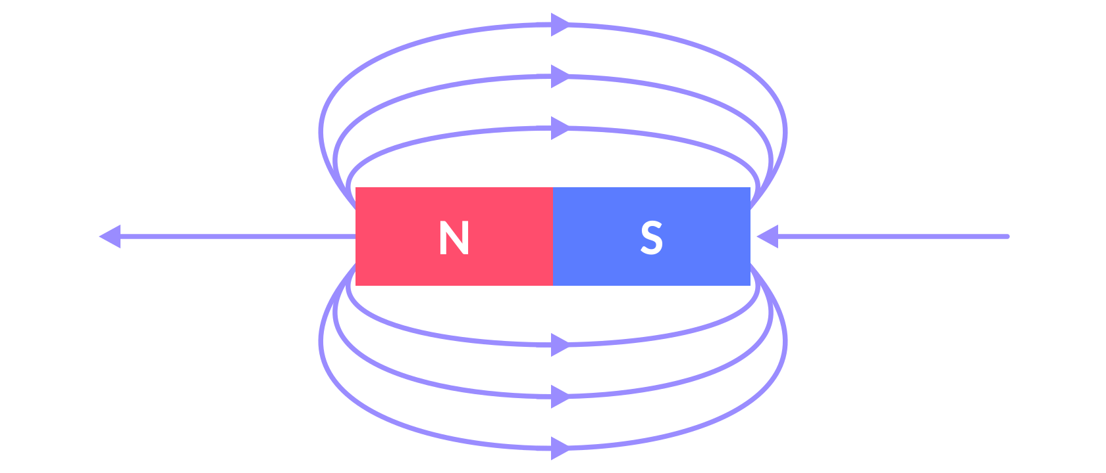
Magnets & magnetic fields
TOPIC 7 · MAGNETISM & ELECTROMAGNETISM
07
‹ INDEX
Permanent vs induced magnets
Permanent: produces its own magnetic field all the time (e.g. bar magnet).
Induced: becomes magnetic only when in a magnetic field; loses most/all magnetism when removed. Induced magnetism always attracts.
Field lines go from N to S. Closer lines = stronger field.
Plotting field lines & the Earth
1. Place a bar magnet on paper; put a plotting compass near it.
2. Mark where the needle points; move the compass to that dot and repeat.
3. Join the dots and add arrows (N → S).
A compass points north because the Earth’s core is magnetic – evidence the Earth has a magnetic field.
Poles
Like poles repel (N–N, S–S). Opposite poles attract (N–S).
Magnetic force is a non-contact force, strongest at the poles.
Magnetic materials: iron, steel, cobalt, nickel.

Slide 64
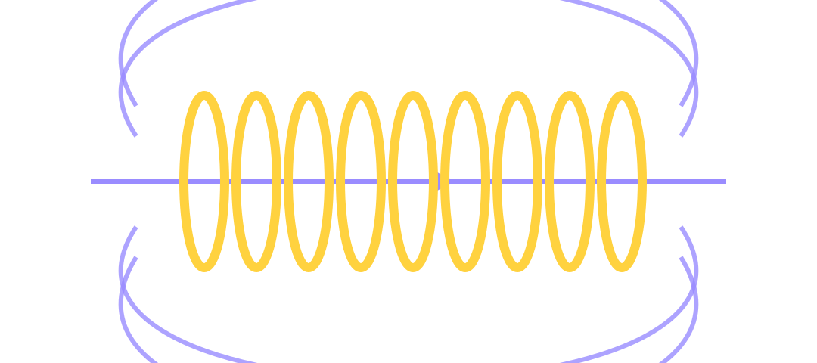
Electromagnetism
TOPIC 7 · MAGNETISM & ELECTROMAGNETISM
07
‹ INDEX
Current in a wire
Solenoid
Make it stronger
Add an iron core
More turns on the coil
Bigger current
Field inside is strong & uniform; outside it looks like a bar magnet’s field.
Add an iron core → electromagnet.
Concentric circles round the wire. Stronger with more current and closer to the wire.
Uses of electromagnets
Electric motors · loudspeakers · electric bells · scrapyard cranes · relays · remotely controlled door locks. The key advantage: the magnetism can be switched on and off and its strength changed.

Slide 65
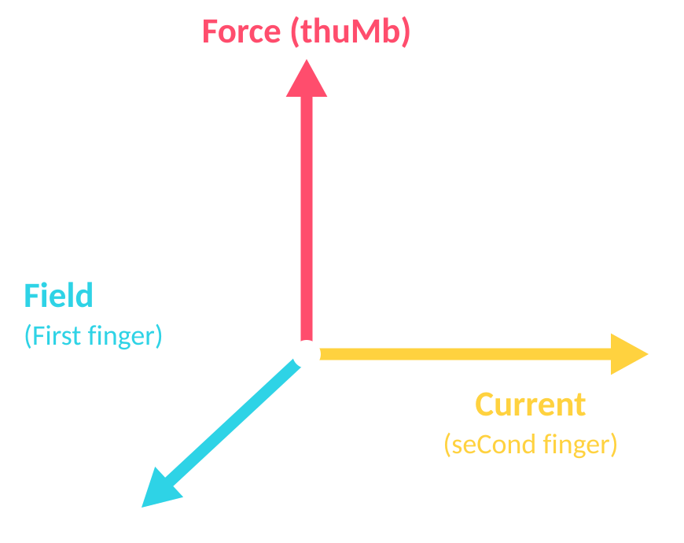
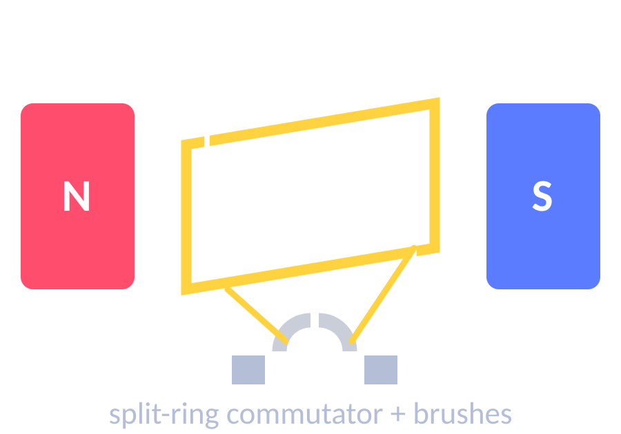
The motor effect
HIGHER TIER
TOPIC 7 · MAGNETISM & ELECTROMAGNETISM
07
‹ INDEX
Fleming’s left-hand rule
FORCE ON A CONDUCTOR (HT)
F = B I l
Thumb
Force / motion
F in N · B (magnetic flux density) in T · I in A · l in m
First finger
Field (N → S)
Second finger
Current (+ → −)
WORKED EXAMPLE
8 A flows in a 75 cm wire at right angles to a 0.5 T field. Find the force.
l = 0.75 m; F = 0.5 × 8 × 0.75
Electric motor
F = 3 N
Forces on each side act in opposite directions → the coil turns.
A split-ring commutator reverses the current every half turn.
No force if the wire is parallel to the field.
WORKED EXAMPLE
A 0.1 m wire in a 0.2 T field feels 0.06 N. Find the current.
I = F ÷ (B l) = 0.06 ÷ (0.2 × 0.1)
I = 3 A

Slide 66
Generator effect, microphones & speakers
★ PHYSICS ONLY
HIGHER TIER
TOPIC 7 · MAGNETISM & ELECTROMAGNETISM
07
‹ INDEX
The generator effect (induced potential)
Output p.d.
Moving a wire relative to a magnetic field (or changing the field) induces a p.d.; in a closed circuit a current flows.
Reverse the motion or the poles → the p.d. reverses. HT: the induced current’s field opposes the change.
Bigger p.d.: stronger magnet, more turns, faster movement.
p.d.
time
time
Alternator → AC
Dynamo → DC
Alternators & dynamos
Loudspeakers & microphones (HT)
Alternator: coil rotates in a field; slip rings keep contact → AC.
Dynamo: uses a split-ring commutator → DC (always the same direction).
Turning faster gives a bigger p.d. and a higher frequency.
Loudspeaker – motor effect: AC in the coil → changing force on the cone → cone vibrates → sound wave.
Microphone – generator effect: sound vibrates the diaphragm → coil moves in the field → induced p.d. matching the sound.

Slide 67
Transformers
★ PHYSICS ONLY
HIGHER TIER
TOPIC 7 · MAGNETISM & ELECTROMAGNETISM
07
‹ INDEX
TURNS RATIO (HT)
100% EFFICIENT
V_{p} ÷ V_{s} = n_{p} ÷ n_{s}
V_{p} I_{p} = V_{s} I_{s}
iron core
V in volts · n = turns
power in = power out
WORKED EXAMPLE
primary
secondary
110 V is stepped up to 230 V; output current 6 A. Find the primary current.
I_{p} = V_{s} I_{s} ÷ V_{p} = 230 × 6 ÷ 110
I_{p} = 12.5 A
How it works
AC in the primary → changing magnetic field in the iron core → induces an alternating p.d. in the secondary. Only works with AC.
Step-up: more turns on the secondary. Step-down: fewer.
WORKED EXAMPLE
HT: 230 V across 2000 primary turns; 100 secondary turns. Find V_{s}.
V_{s} = V_{p} × n_{s} ÷ n_{p} = 230 × 100 ÷ 2000
V_{s} = 11.5 V

Slide 68
Examiner tips
TOPIC 7 · MAGNETISM & ELECTROMAGNETISM
07
‹ INDEX
1
Field-line rules
2
Left-hand rule
3
F = B I l
4
Stronger electromagnet
Lines go N → S, never cross, and are closest where the field is strongest.
First finger = Field, seCond finger = Current, thuMb = Motion (force).
Convert cm → m first. It only applies when the wire is at 90° to the field.
More turns, bigger current, add an iron core.
Induced magnets
Explain the motor
★
★
5
6
7
Transformers need AC
8
Generator wording
Induced magnetism always attracts – only permanent magnets can repel.
Forces on opposite sides act in opposite directions; the commutator reverses the current every half turn.
Only a changing magnetic field induces a p.d. in the secondary coil.
Say “relative movement” between the magnet and the coil/wire.

Slide 69

Space Physics
08
‹ INDEX
IN THIS TOPIC
70 Life cycle of stars ★
71 Orbits & the Big Bang ★
72 Examiner tips
The solar system, stars, orbits & the Big Bang

Slide 70
Solar system & life cycle of stars
★ PHYSICS ONLY
TOPIC 8 · SPACE PHYSICS
08
‹ INDEX
Our solar system
Life cycle of a star
One star (the Sun), 8 planets and dwarf planets such as Pluto.
Moons orbit planets – natural satellites. Artificial satellites are built by humans and mostly orbit Earth.
The solar system is part of the Milky Way galaxy.
The Sun formed from a nebula of dust and gas pulled together by gravity.
Nebula
Protostar
Main sequence
Sun-like
massive
Black dwarf
White dwarf
Red giant
Neutron star / black hole
Supernova
Red super giant
Main sequence is stable: inward gravity balances outward pressure from fusion of hydrogen into helium. Elements up to iron form by fusion in stars; heavier elements form in supernovae, which scatter them through space.

Slide 71
Orbits, red-shift & the Big Bang
★ PHYSICS ONLY
TOPIC 8 · SPACE PHYSICS
08
‹ INDEX
Red-shift
Orbits
Sun / lab
Gravity provides the centripetal force for planets, moons and satellites.
HT: in a circular orbit the speed is constant but velocity changes. A smaller orbit needs a higher speed; if speed changes, the radius must change.
Distant galaxy
lines shift towards the red end →
The Big Bang
The universe began from a tiny, extremely hot and dense region about 13.8 billion years ago, and has expanded ever since. Red-shift supports this theory.
The expanding universe
Light from distant galaxies has longer wavelengths – they are moving away from us.
Further galaxies show more red-shift, so they are moving away faster → the universe is expanding (like dots on an inflating balloon).
Dark matter & dark energy
Since 1998, supernovae show distant galaxies receding faster – expansion is accelerating. We don’t yet understand why.

Slide 72
Examiner tips
TOPIC 8 · SPACE PHYSICS
08
‹ INDEX
1
Life cycle in order
2
Why stars are stable
3
Red-shift evidence
Learn both routes: Sun-like stars → white dwarf; massive stars → supernova → neutron star/black hole.
Gravity inwards is balanced by outward pressure from fusion.
Further galaxies → bigger red-shift → moving away faster → universe expanding.
4
Orbits (HT)
5
Making elements
6
Theory vs evidence
Speed is constant but velocity changes because the direction changes.
Elements heavier than iron are made in supernovae.
The Big Bang is a theory supported by red-shift; dark matter and dark energy are still unexplained.

Slide 73

Equation Bank
09
‹ INDEX
IN THIS TOPIC
74 All equations by topic
75 Equation sheet, units & prefixes
Every equation, units & prefixes

Slide 74
Equations by topic
EQUATION BANK
09
‹ INDEX
The equation sheet is provided in the exam and all of these are on it – your job is to pick the right one, rearrange it and use SI units.
01
Energy
02
Electricity
05
Forces
05
Forces
06
Waves
E_{k} = ½ m v²
Q = I t
W = m g
M = F d ★
v = f λ
E_{p} = m g h
V = I R
F = m a
p = F ÷ A ★
T = 1 ÷ f
E_{e} = ½ k e²
P = V I
W = F s
p = h ρ g (HT) ★
magnification ★
ΔE = m c Δθ
P = I² R
F = k e
F = m Δv ÷ Δt (HT) ★
07
Magnetism
P = E ÷ t
E = P t
s = v t
03
Particles
F = B I l (HT)
P = W ÷ t
E = Q V
a = Δv ÷ t
ρ = m ÷ V
V_{p} ÷ V_{s} = n_{p} ÷ n_{s} (HT) ★
efficiency = useful ÷ total
v² − u² = 2 a s
E = m L
V_{p} I_{p} = V_{s} I_{s} (HT) ★
p = m v (HT)
p V = constant ★

Slide 75
Using the equation sheet, units & prefixes
EQUATION BANK
09
‹ INDEX
How to answer a calculation question
Quantity | Unit | Symbol
Energy / work | joule | J
Power | watt | W
Force / weight | newton | N
Charge | coulomb | C
Current | ampere | A
Potential difference | volt | V
Resistance | ohm | Ω
Frequency | hertz | Hz
Activity | becquerel | Bq
Flux density | tesla | T
Pressure | pascal | Pa
Moment | newton metre | N m
Prefix | ×
giga (G) | 10⁹
mega (M) | 10⁶
kilo (k) | 10³
centi (c) | 10⁻²
milli (m) | 10⁻³
micro (µ) | 10⁻⁶
nano (n) | 10⁻⁹
1
List the values Write each value with its unit. Convert to SI: g → kg, cm → m, kJ → J, minutes → s.
2
Choose the equation Find the one on the sheet that links what you know to what you want – knowing the common ones by heart saves time.
3
Rearrange Rearrange first, or substitute then rearrange – show it either way.
4
Calculate Keep the full calculator value until the end.
5
Unit & sig figs Give the unit and round to the same number of significant figures as the least precise data value.
6
Sense-check Is the size sensible? (A person can’t run at 300 m/s!)

